Slide 1
Chapter 9 Object-Oriented Programming: Inheritance

Slide 2
Objectives
Understand inheritance and how to use it to develop new classes based on existing classes
Learn the notions of superclasses and subclasses and the relationship between them.
Use keyword extends to create a class that inherits attributes and behaviors from another class
Use access modifier protected in a superclass to give subclass methods access to these superclass members
Access superclass members with super from a subclass
Learn how constructors are used in inheritance hierarchies
Learn about the methods of class Object, the direct or indirect superclass of all classes.

Slide 3
9.1 Introduction
Inheritance
A form of software reuse in which a new class is created by absorbing an existing class’s members and embellishing them with new or modified capabilities.
Can save time during program development by basing new classes on existing proven and debugged high-quality software.
Increases the likelihood that a system will be implemented and maintained effectively.

Slide 4
9.1 Introduction (Cont.)
When creating a class, rather than declaring completely new members, you can designate that the new class should inherit the members of an existing class.
Existing class is the superclass
New class is the subclass
Each subclass can be a superclass of future subclasses.
A subclass can add its own fields and methods.
A subclass is more specific than its superclass and represents a more specialized group of objects.
The subclass exhibits the behaviors of its superclass and can add behaviors that are specific to the subclass.
This is why inheritance is sometimes referred to as specialization.

Slide 5
9.1 Introduction (Cont.)
The direct superclass is the superclass from which the subclass explicitly inherits.
An indirect superclass is any class above the direct superclass in the class hierarchy.
The Java class hierarchy begins with class Object (in package java.lang)
Every class in Java directly or indirectly extends (or “inherits from”) Object.
Java supports only single inheritance, in which each class is derived from exactly one direct superclass.

Slide 6
9.1 Introduction (Cont.)
We distinguish between the is-a relationship and the has-a relationship
Is-a represents inheritance
In an is-a relationship, an object of a subclass can also be treated as an object of its superclass
Has-a represents composition
In a has-a relationship, an object contains as members references to other objects

Slide 7
9.2 Superclasses and Subclasses
Figure 9.1 lists several simple examples of superclasses and subclasses
Superclasses tend to be “more general” and subclasses “more specific.”
Because every subclass object is an object of its superclass, and one superclass can have many subclasses, the set of objects represented by a superclass is typically larger than the set of objects represented by any of its subclasses.

Slide 8
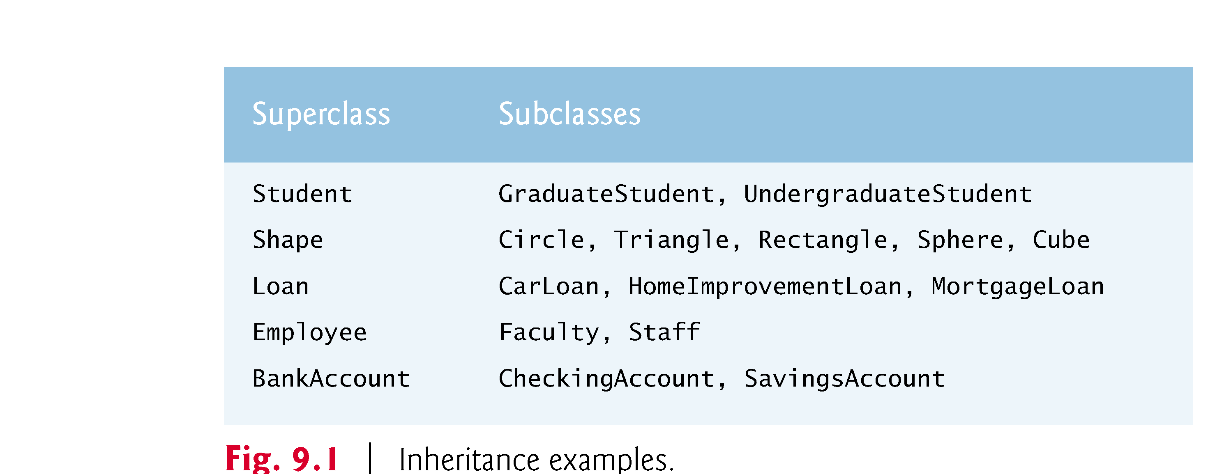

Slide 9
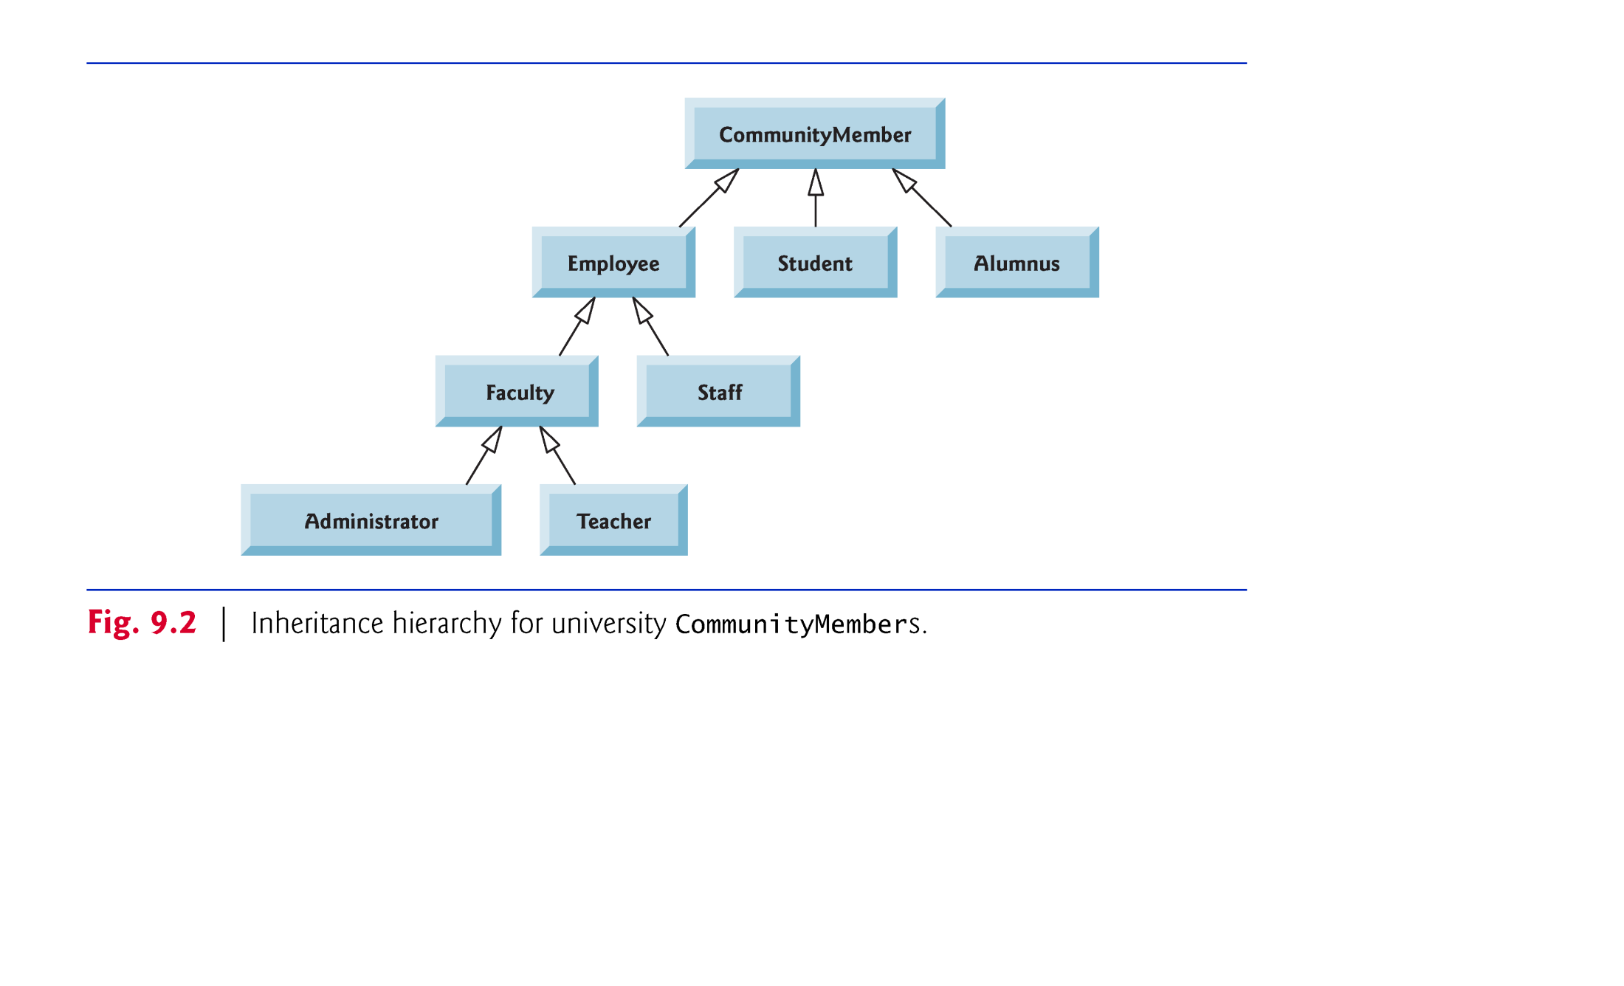

Slide 10
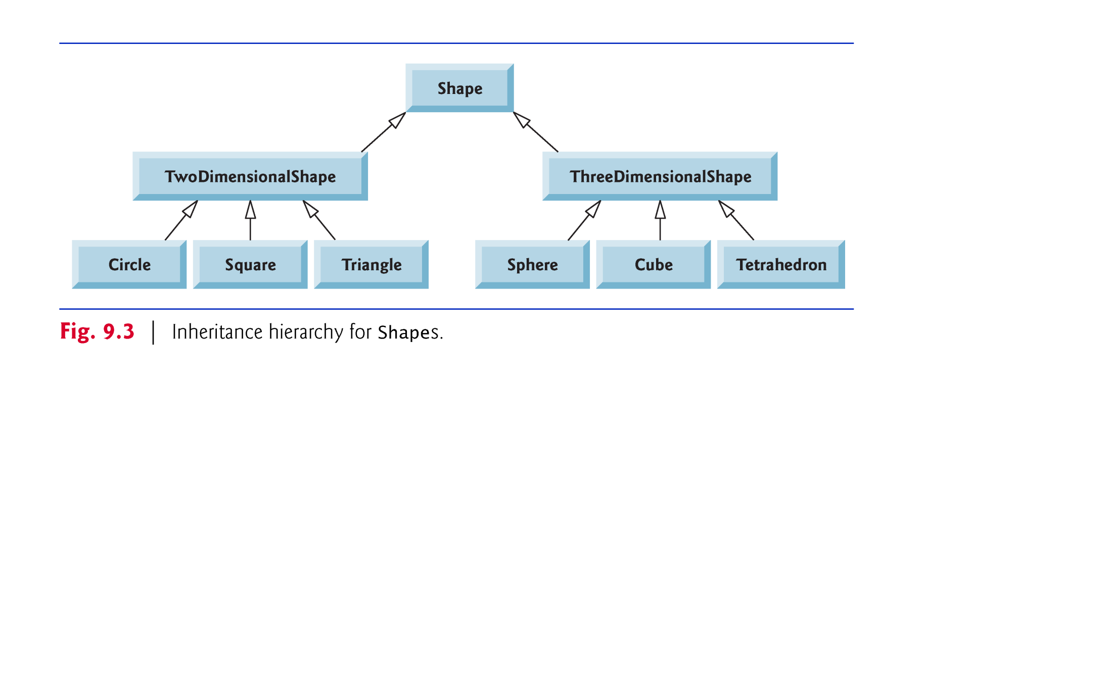

Slide 11
9.2 Superclasses and Subclasses (Cont.)
Not every class relationship is an inheritance relationship.
Has-a relationship
Create classes by composition of existing classes.
Example: Given the classes Employee, BirthDate and TelephoneNumber, it’s improper to say that an Employee is a BirthDate or that an Employee is a TelephoneNumber.
However, an Employee has a BirthDate, and an Employee has a TelephoneNumber.

Slide 12
9.2 Superclasses and Subclasses (Cont.)
Objects of all classes that extend a common superclass can be treated as objects of that superclass.
Commonality expressed in the members of the superclass.
Inheritance issue
A subclass can inherit methods that it does not need or should not have.
Even when a superclass method is appropriate for a subclass, that subclass often needs a customized version of the method.
The subclass can override (redefine) the superclass method with an appropriate implementation.

Slide 13
9.3 protected Members
protected access is an intermediate level of access between public and private.
A superclass’s protected members can be accessed by members of that superclass, by members of its subclasses and by members of other classes in the same package
protected members also have package access.
All public and protected superclass members retain their original access modifier when they become members of the subclass.

Slide 14
9.3 protected Members (Cont.)
A superclass’s private members are hidden in its subclasses
Subclass methods can refer to public and protected members inherited from the superclass simply by using the member names.
When a subclass method overrides an inherited superclass method, the superclass method can be accessed from the subclass by preceding the superclass method name with keyword super and a dot (.) separator.

Slide 15
9.4 Relationship between Superclasses and Subclasses
Inheritance hierarchy containing types of employees in a company’s payroll application
Commission employees are paid a percentage of their sales
Base-salaried commission employees receive a base salary plus a percentage of their sales.

Slide 16
9.4.1 Creating and Using a CommissionEmployee Class
Class CommissionEmployee (Fig. 9.4) extends class Object (from package java.lang).
CommissionEmployee inherits Object’s methods.
If you don’t explicitly specify which class a new class extends, the class extends Object implicitly.

Slide 17
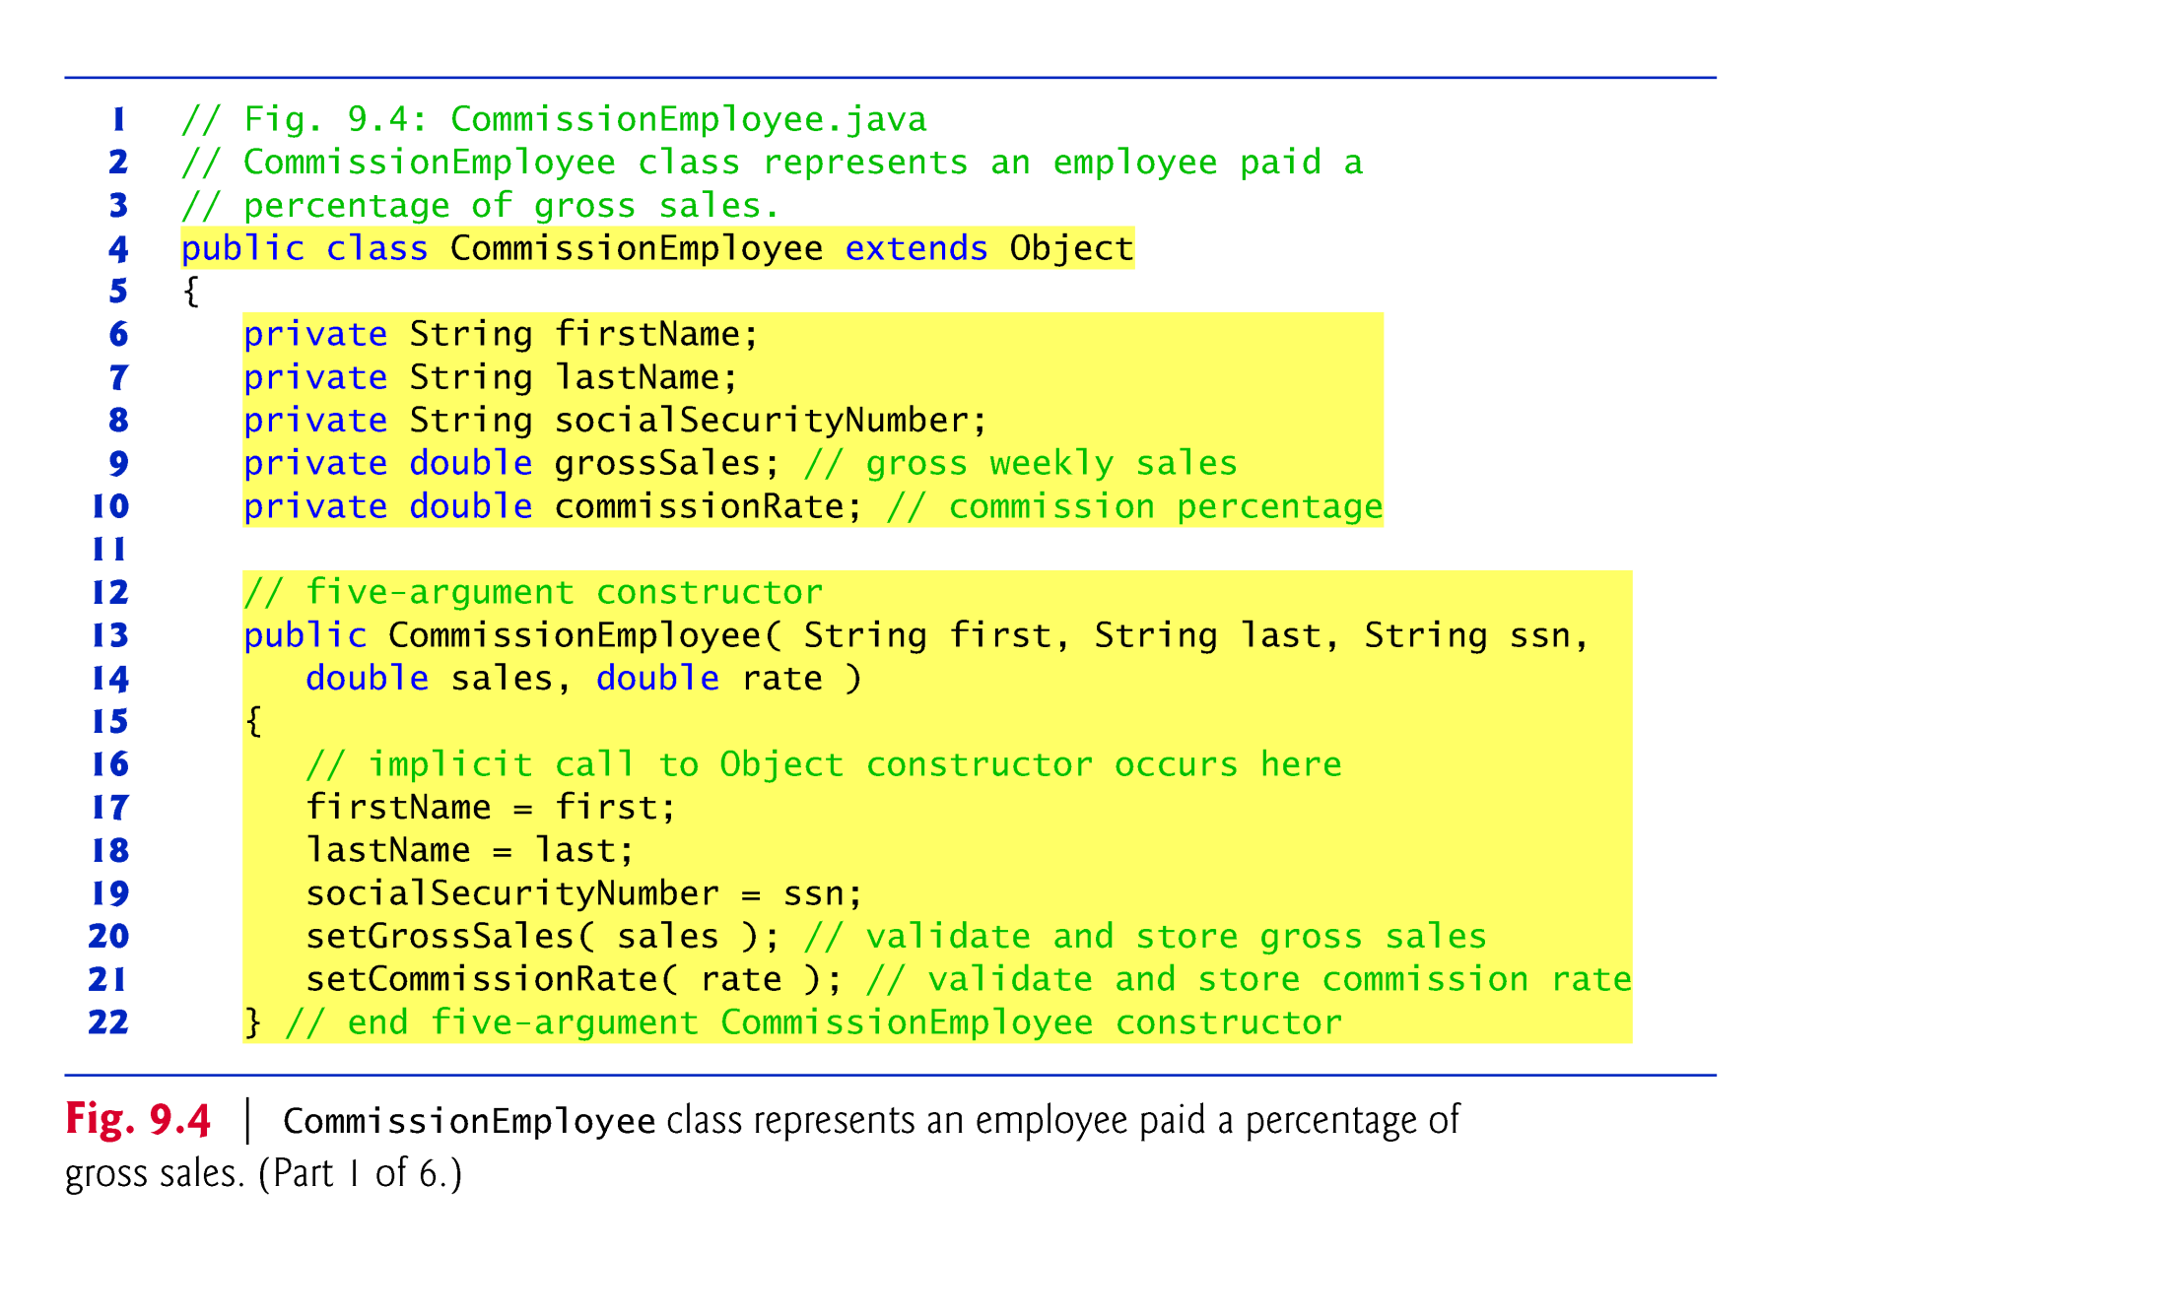

Slide 18
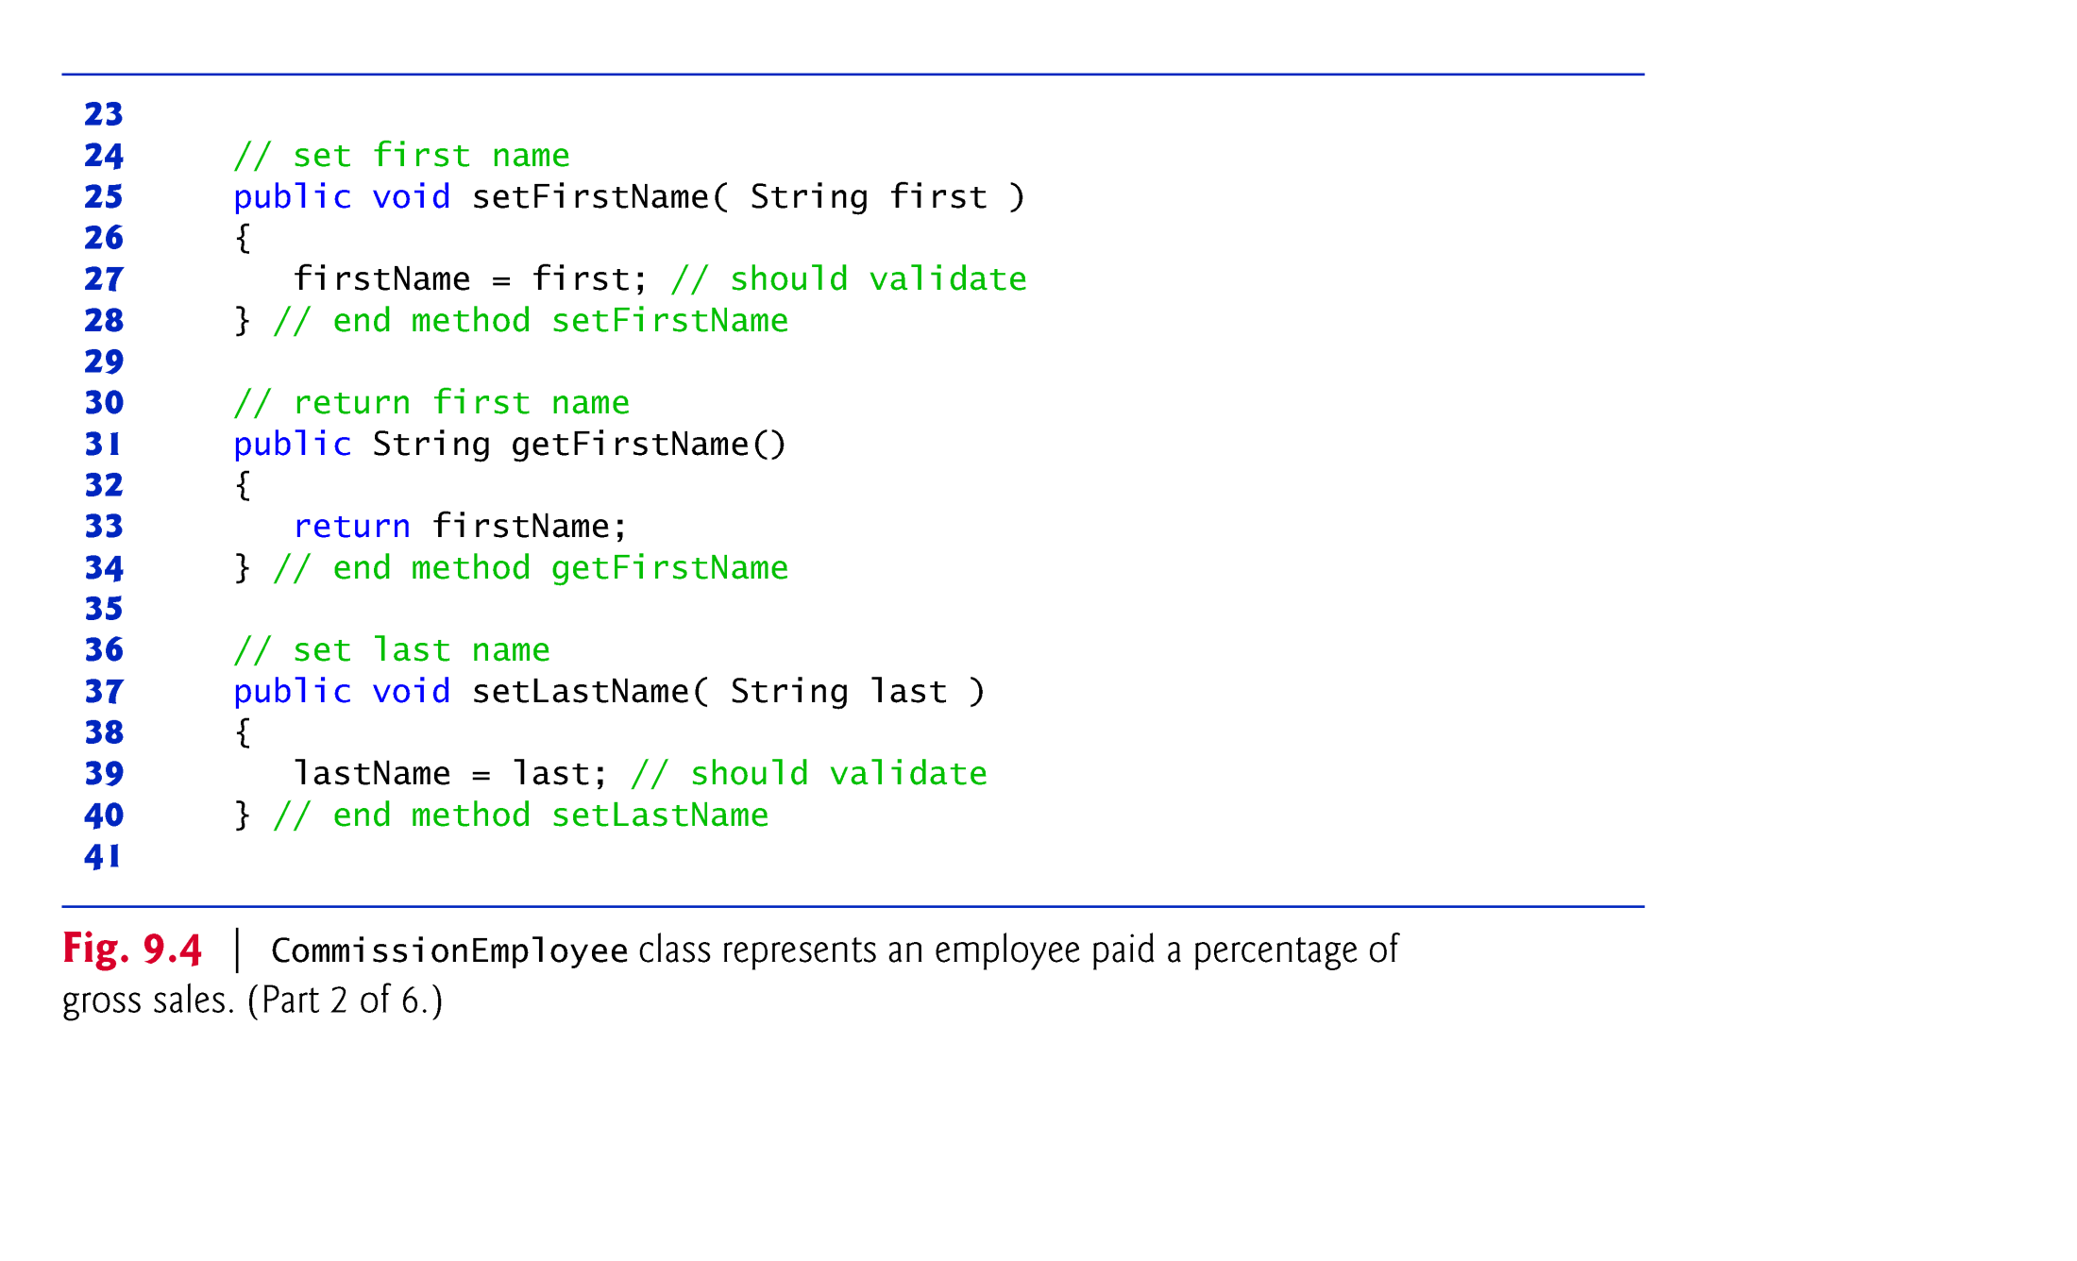

Slide 19
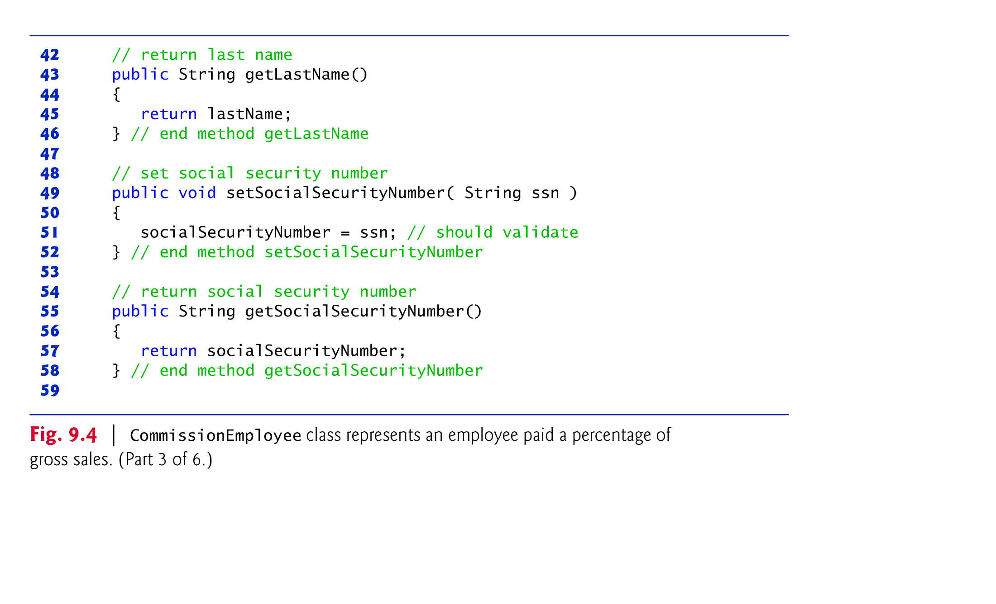

Slide 20
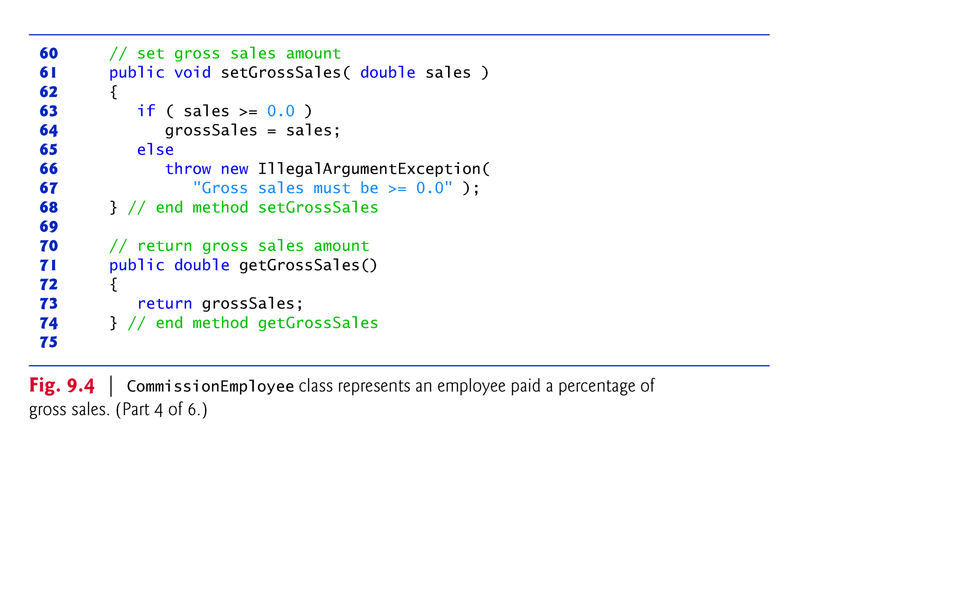

Slide 21
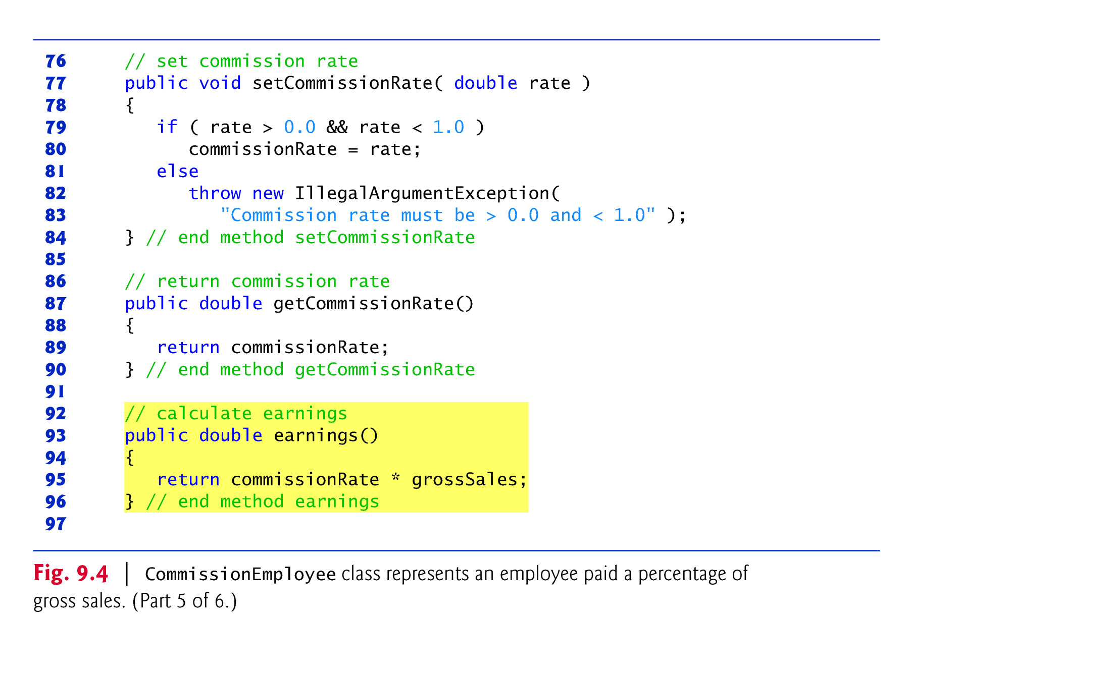

Slide 22
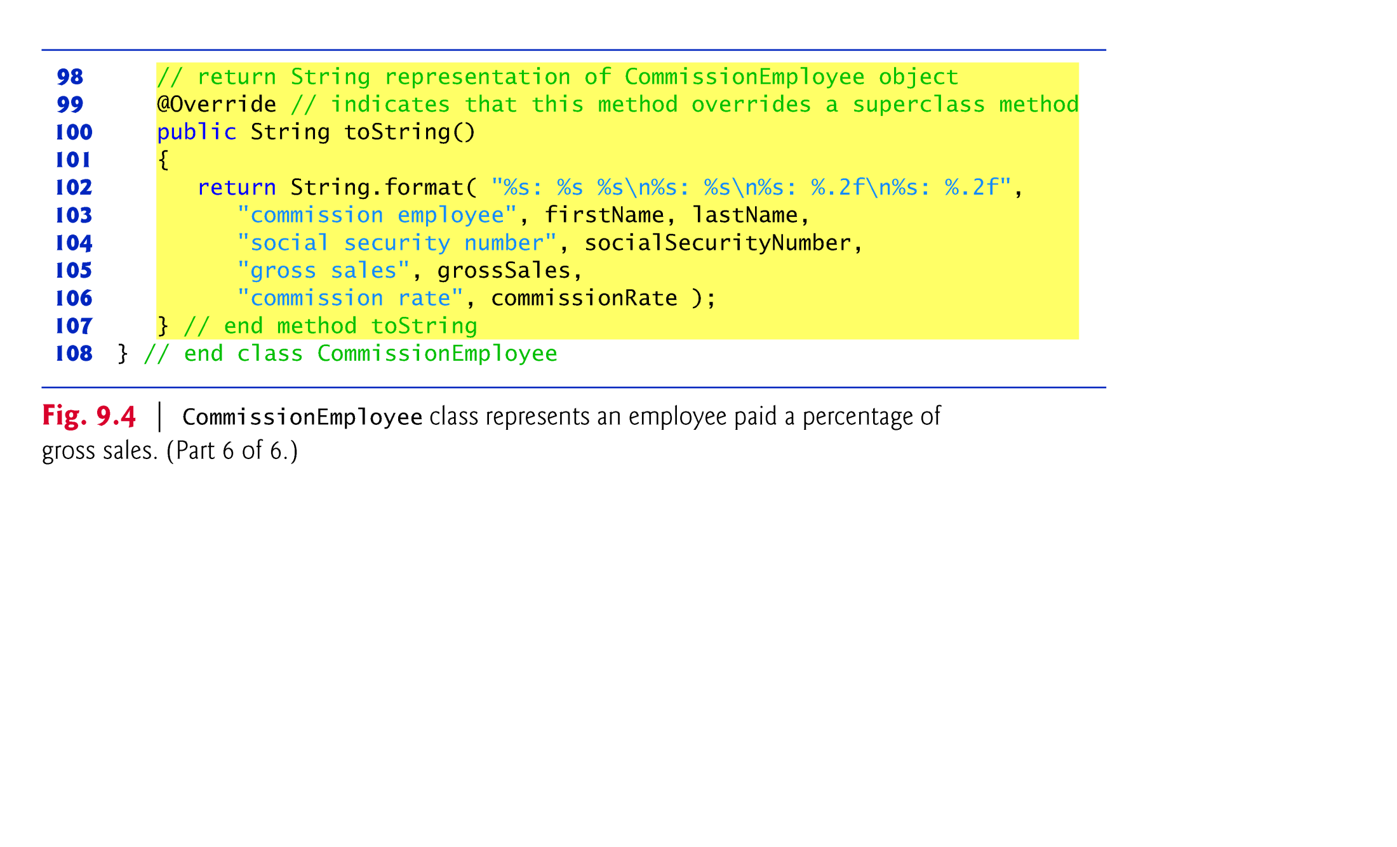

Slide 23
9.4.1 Creating and Using a CommissionEmployee Class (Cont.)
Constructors are not inherited.
The first task of a subclass constructor is to call its direct superclass’s constructor explicitly or implicitly
Ensures that the instance variables inherited from the superclass are initialized properly.
If the code does not include an explicit call to the superclass constructor, Java implicitly calls the superclass’s default or no-argument constructor.
A class’s default constructor calls the superclass’s default or no-argument constructor.

Slide 24
9.4.1 Creating and Using a CommissionEmployee Class (Cont.)
toString is one of the methods that every class inherits directly or indirectly from class Object.
Returns a String representing an object.
Called implicitly whenever an object must be converted to a String representation.
Class Object’s toString method returns a String that includes the name of the object’s class.
This is primarily a placeholder that can be overridden by a subclass to specify an appropriate String representation.

Slide 25
9.4.1 Creating and Using a CommissionEmployee Class (Cont.)
To override a superclass method, a subclass must declare a method with the same signature as the superclass method
@Override annotation
Indicates that a method should override a superclass method with the same signature.
If it does not, a compilation error occurs.

Slide 26
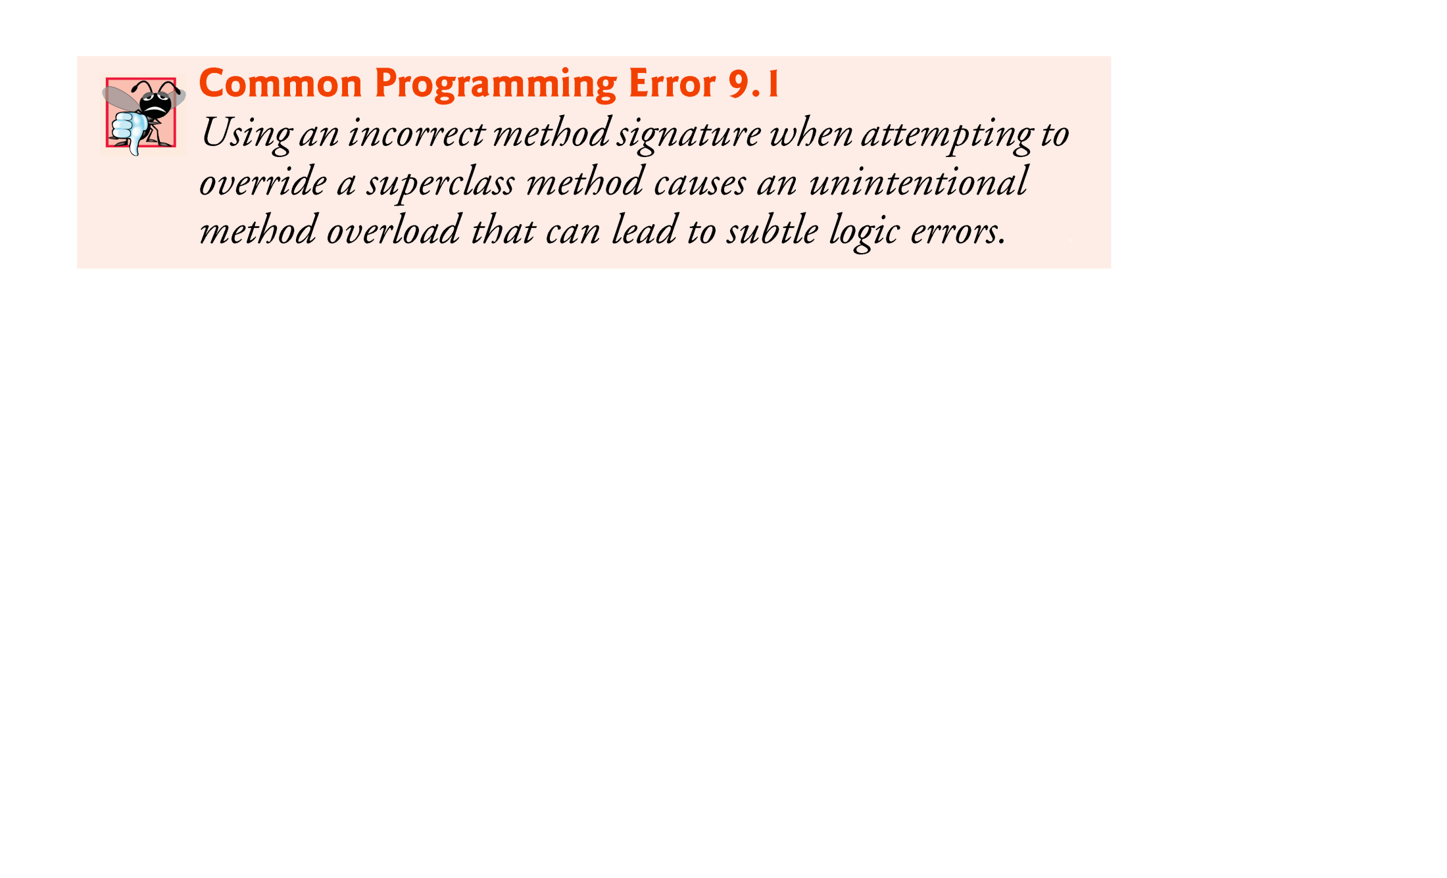

Slide 27
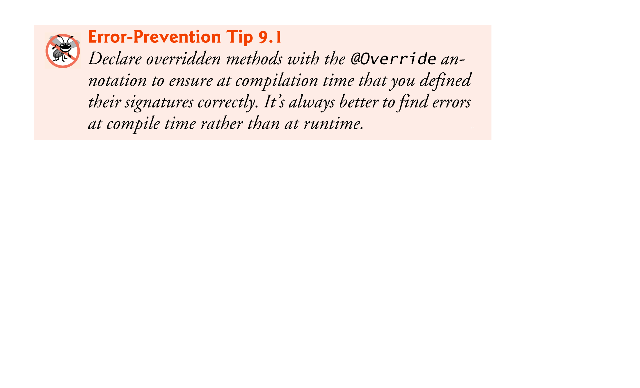

Slide 28
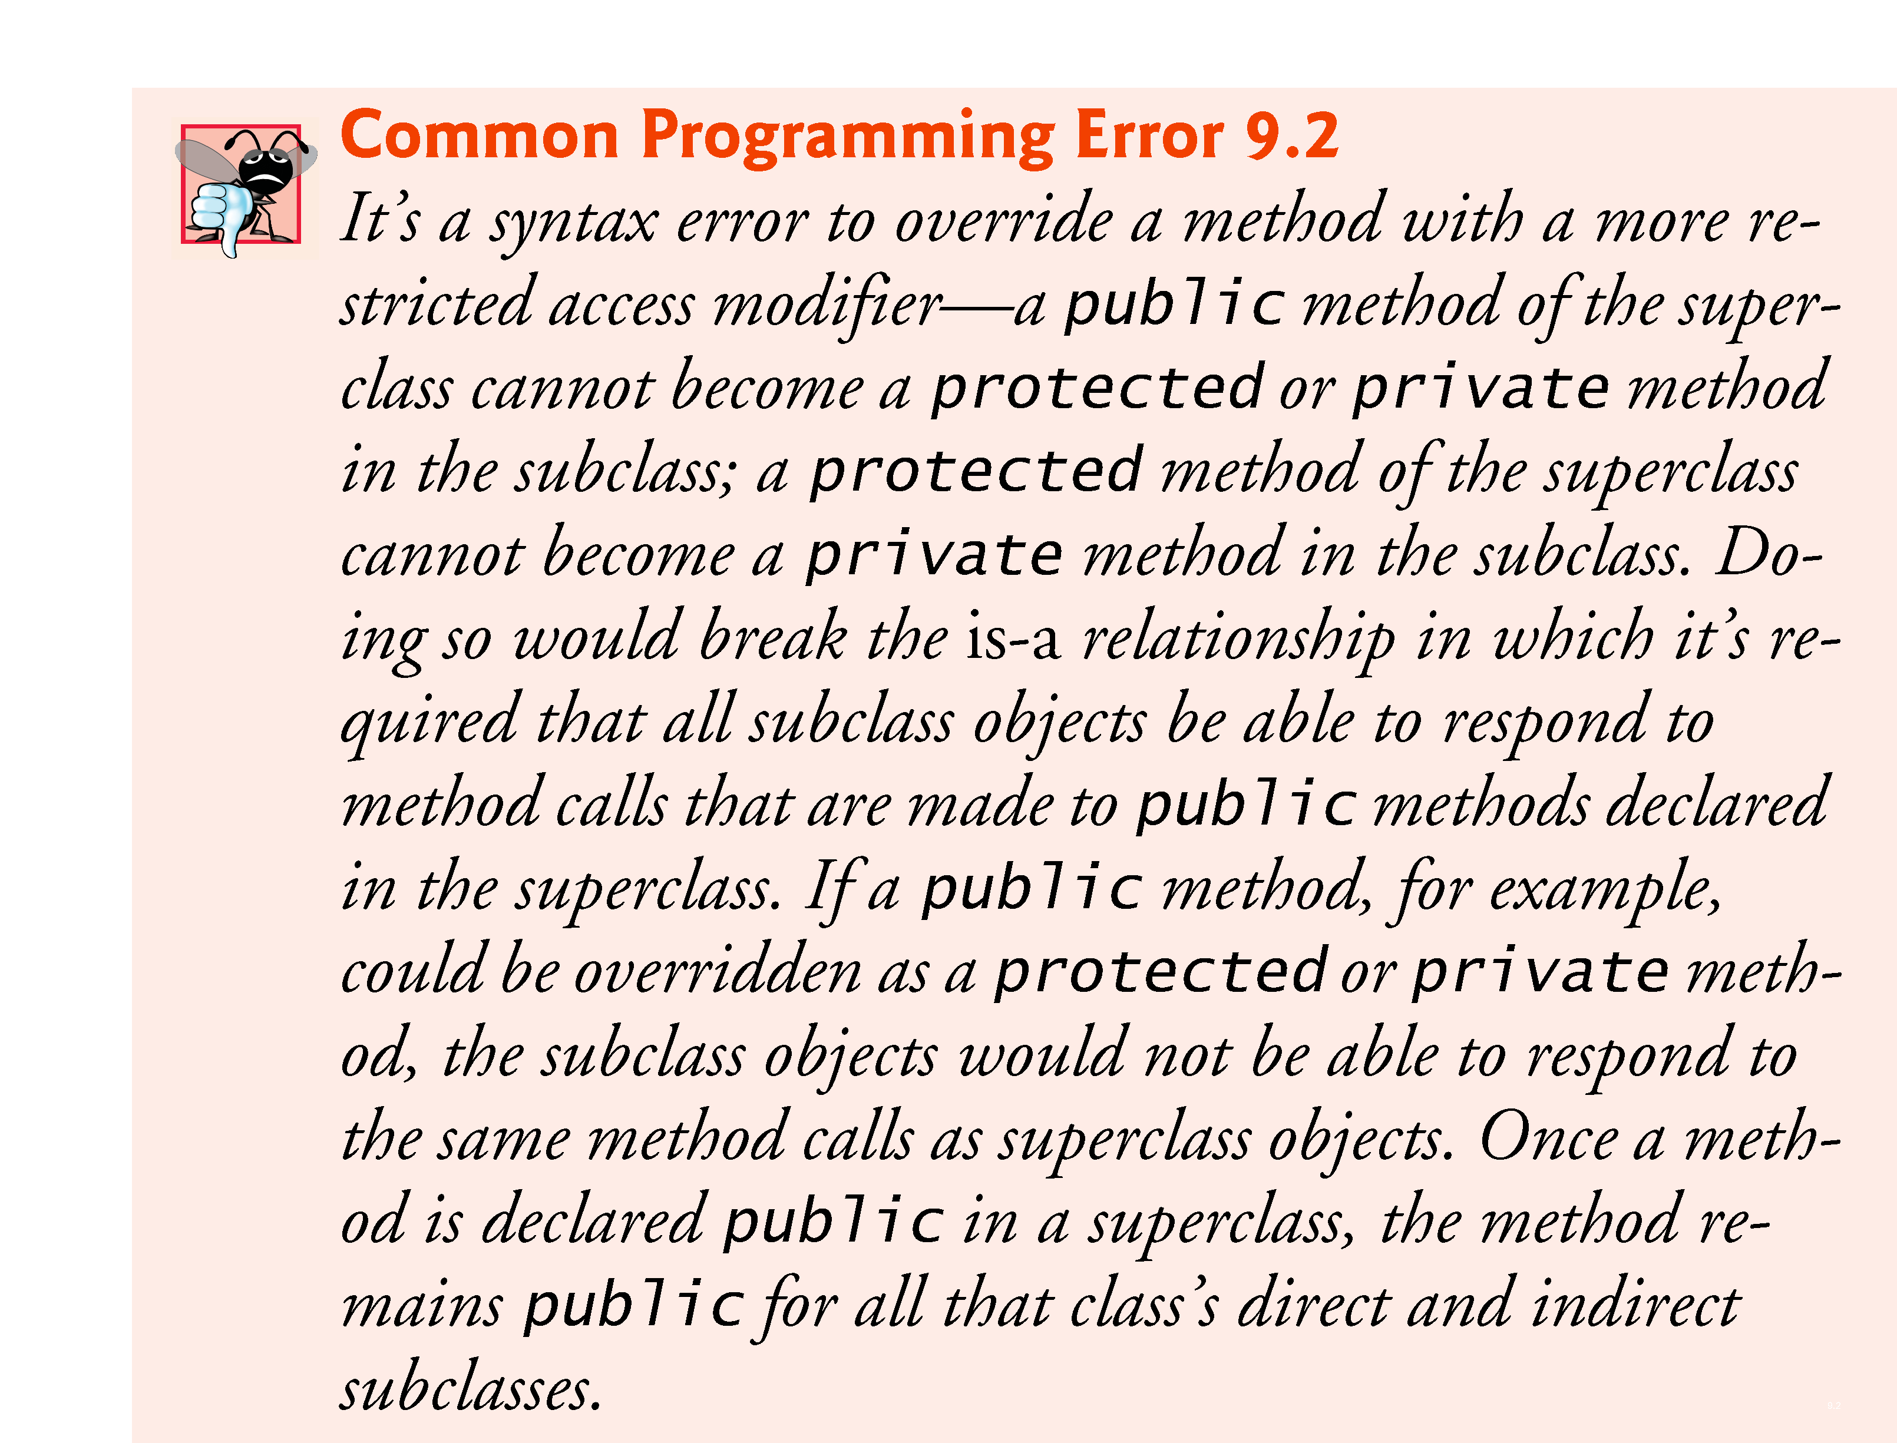

Slide 29
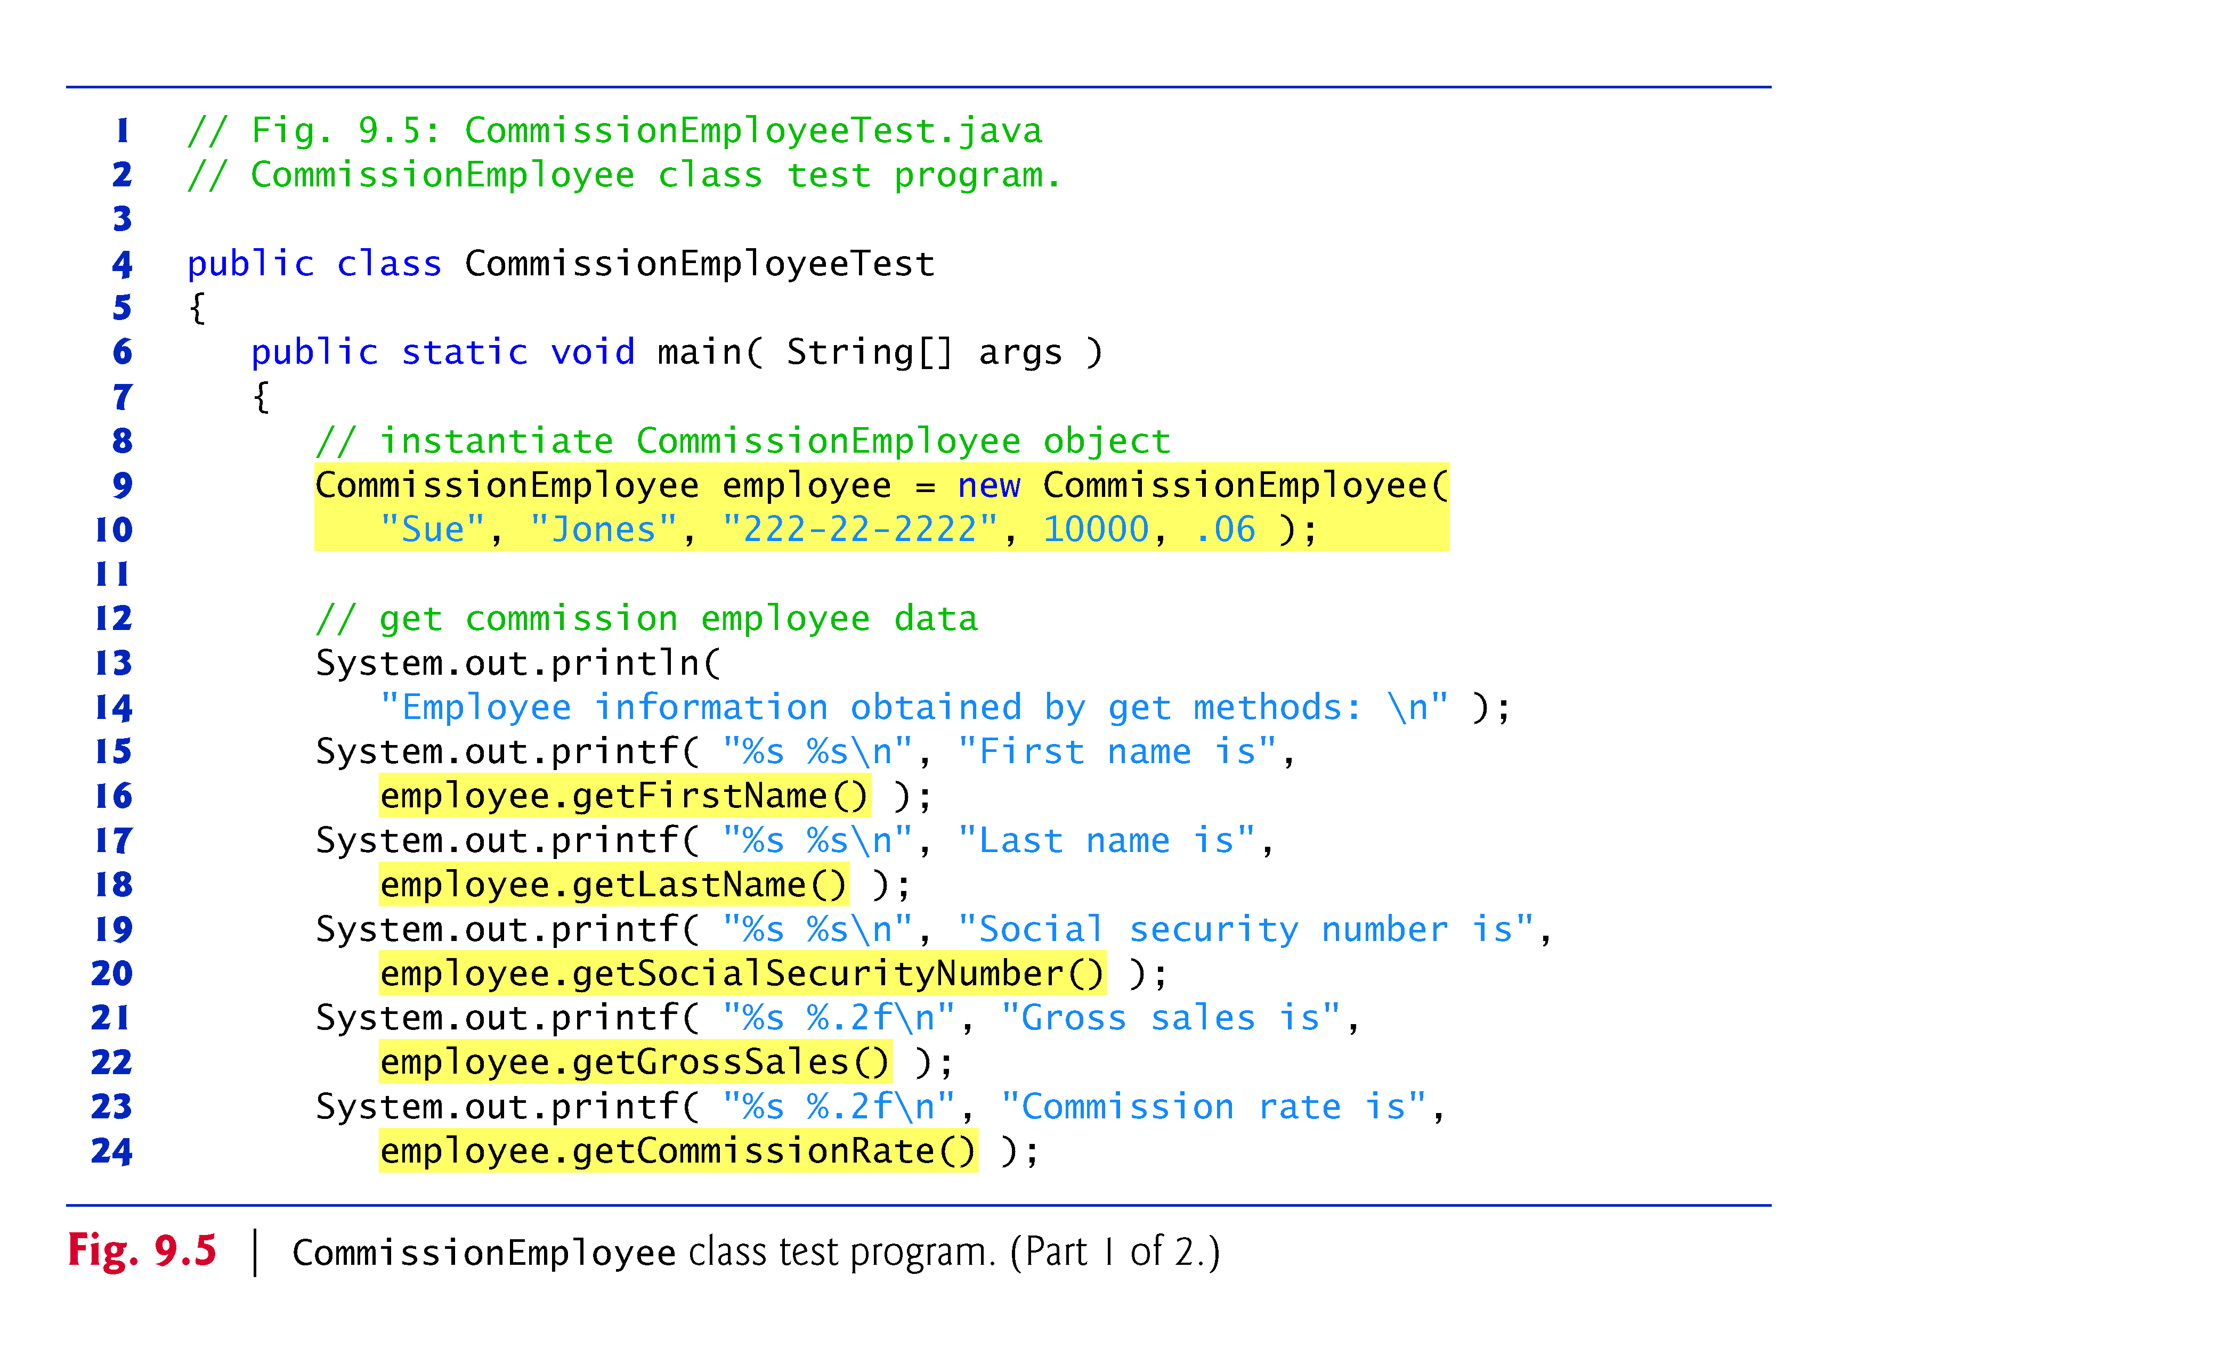

Slide 30
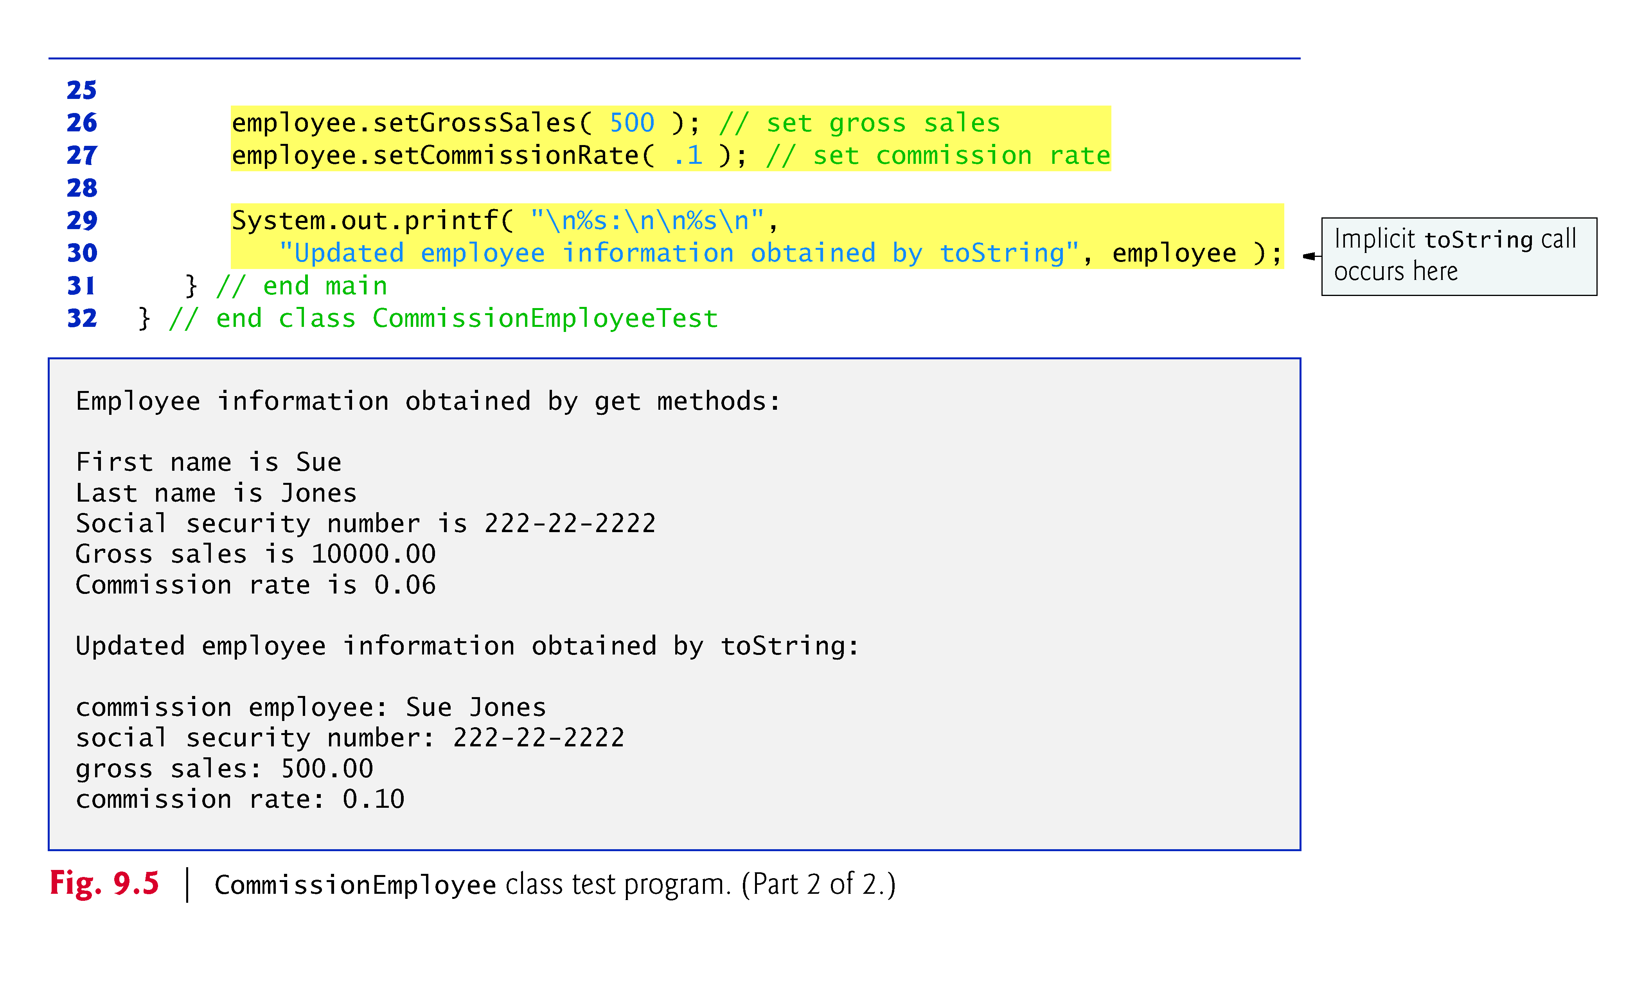

Slide 31
9.4.2 Creating and Using a BasePlus-CommissionEmployee Class
Class BasePlusCommissionEmployee (Fig. 9.6) contains a first name, last name, social security number, gross sales amount, commission rate and base salary.
All but the base salary are in common with class CommissionEmployee.
Class BasePlusCommissionEmployee’s public services include a constructor, and methods earnings, toString and get and set for each instance variable
Most of these are in common with class CommissionEmployee.

Slide 32
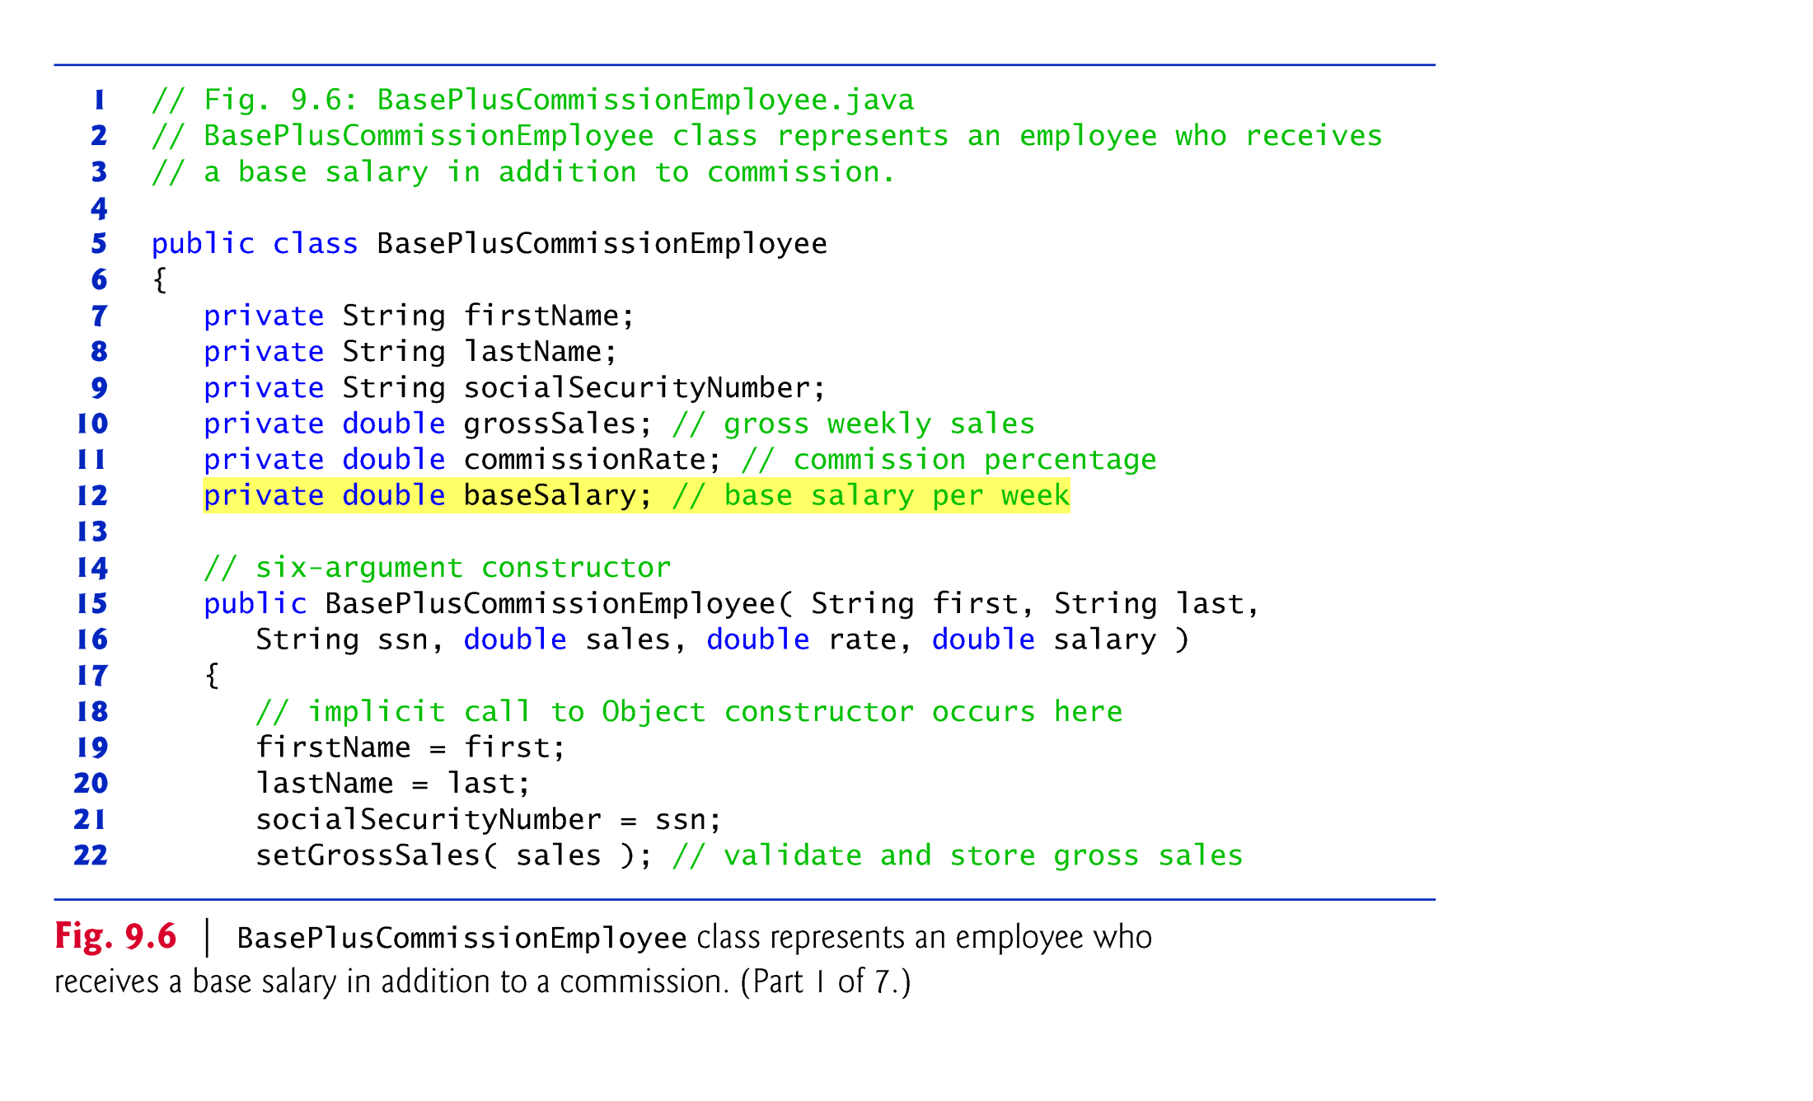

Slide 33
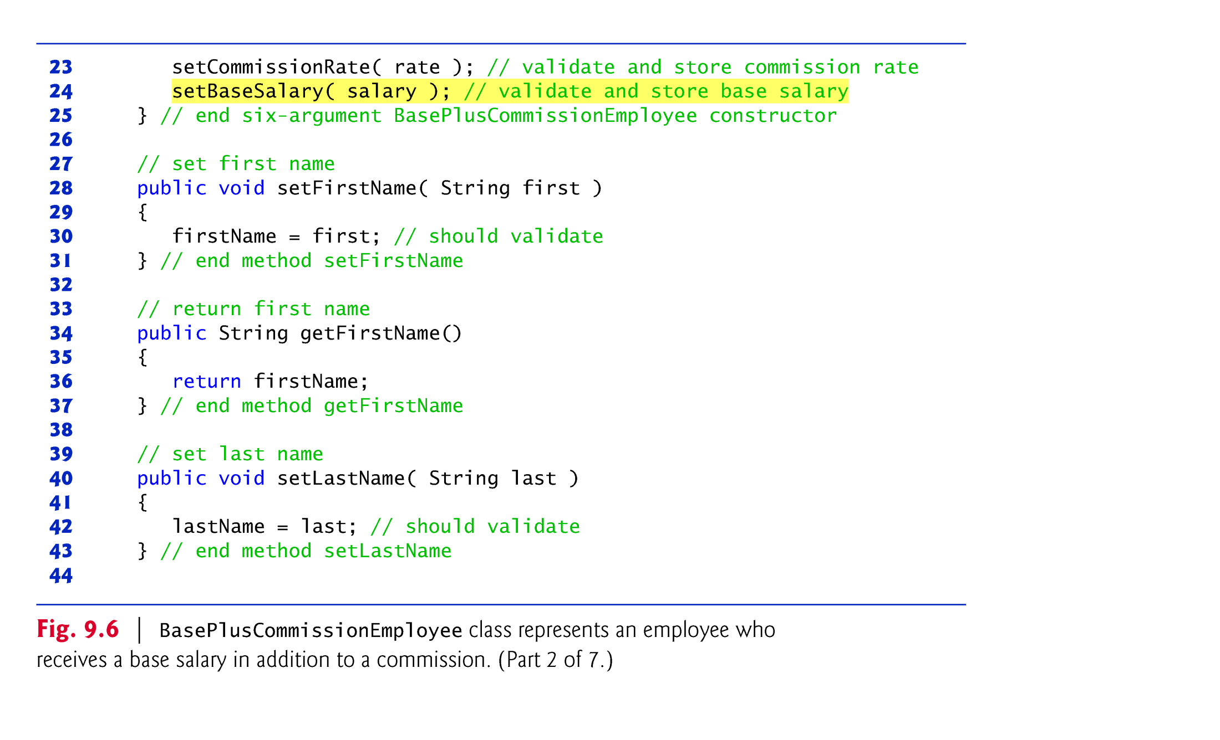

Slide 34
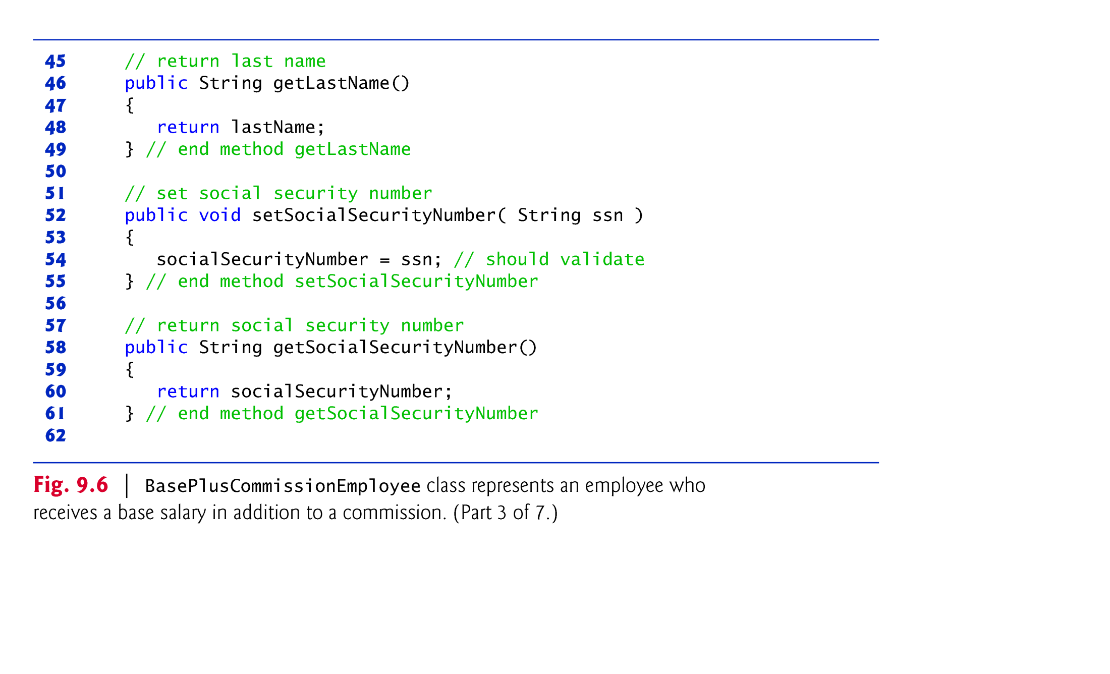

Slide 35
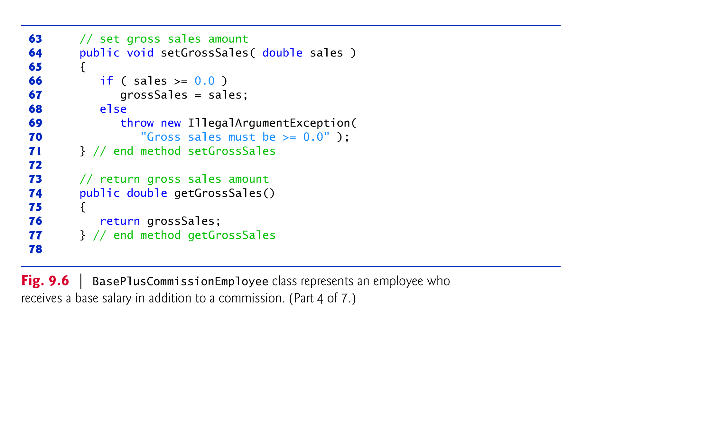

Slide 36
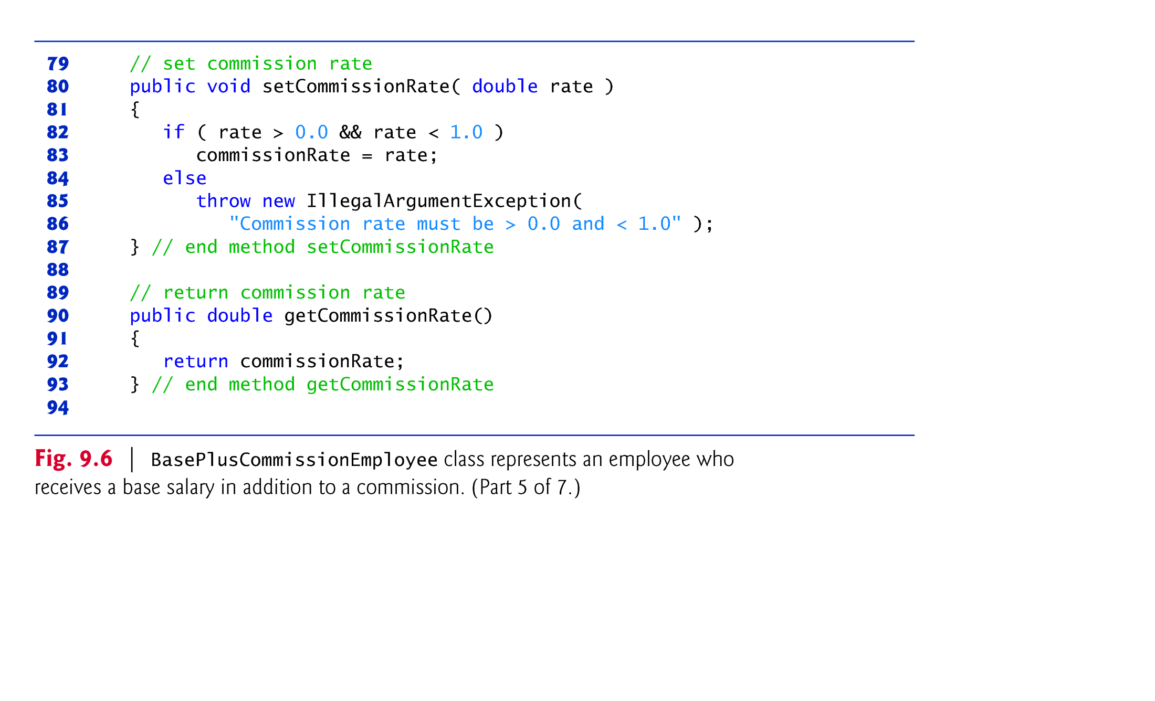

Slide 37
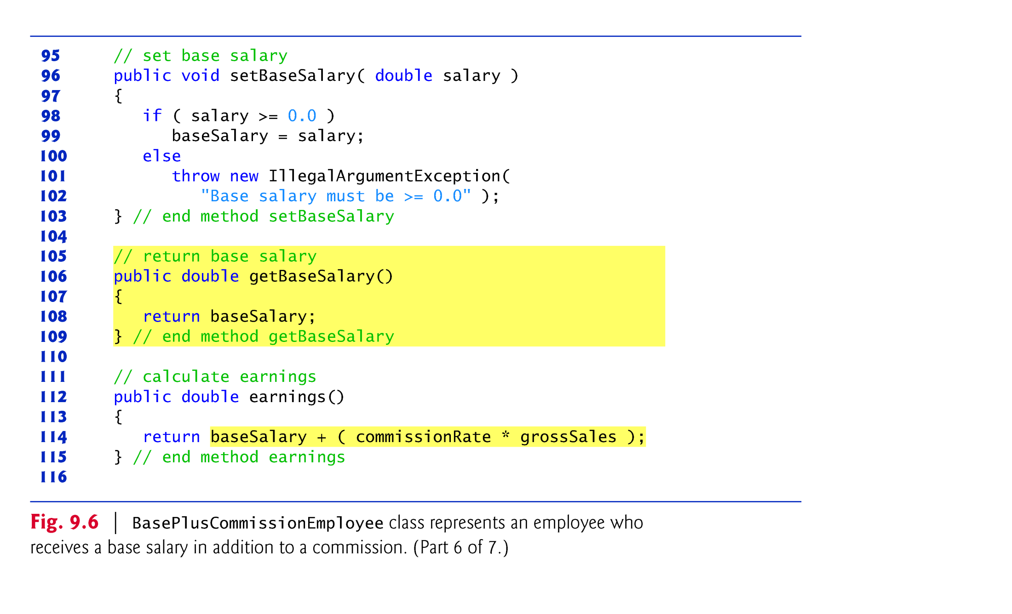

Slide 38
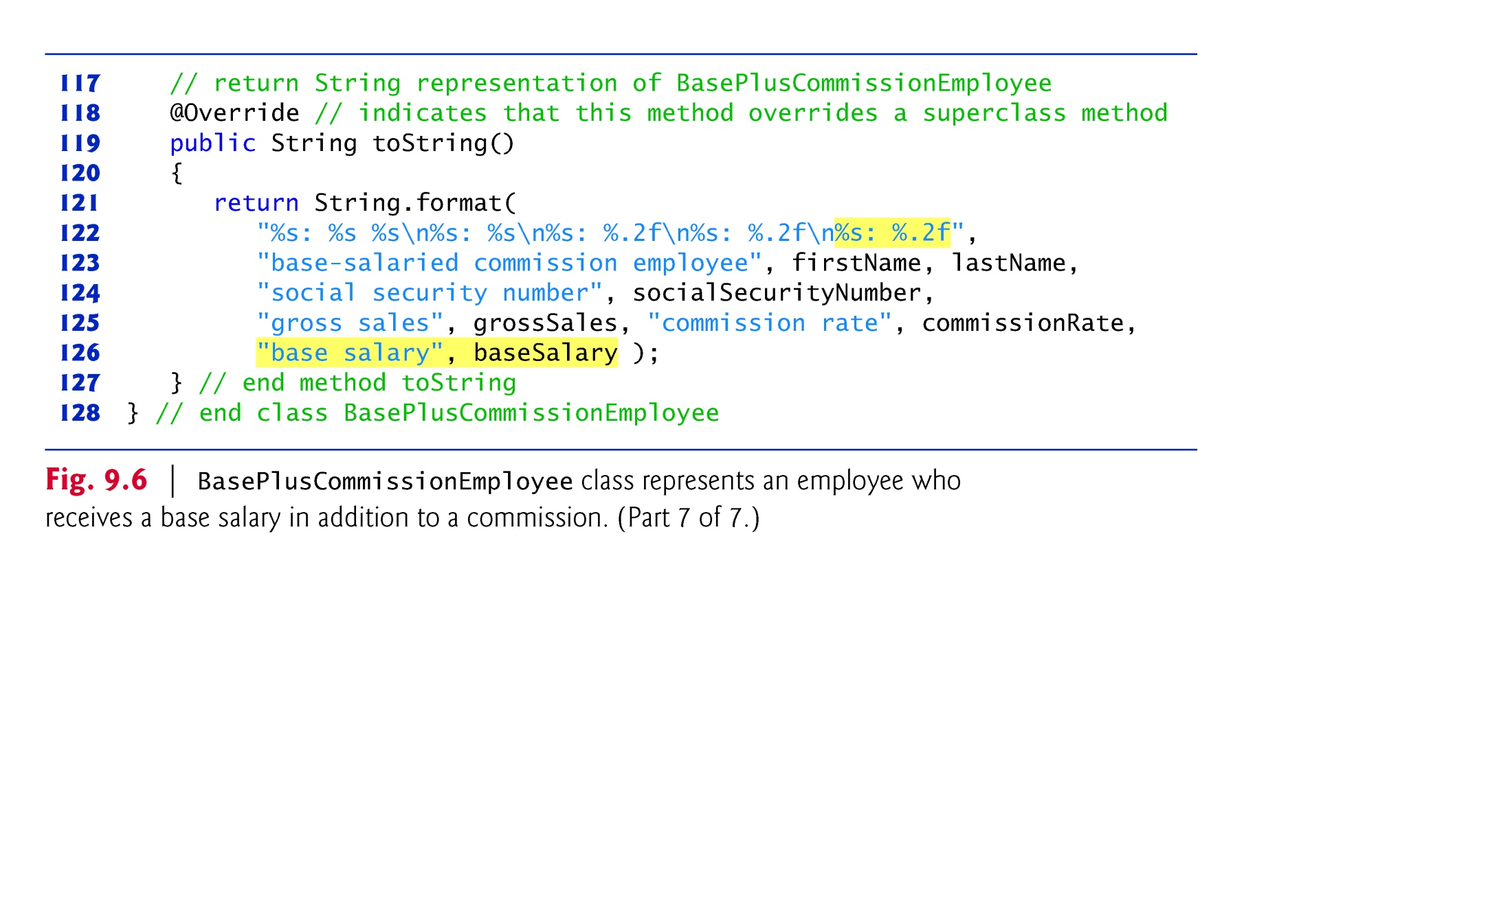

Slide 39
9.4.2 Creating and Using a BasePlus-CommissionEmployee Class (Cont.)
Class BasePlusCommissionEmployee does not specify “extends Object”
Implicitly extends Object.
BasePlusCommissionEmployee’s constructor invokes class Object’s default constructor implicitly.

Slide 40
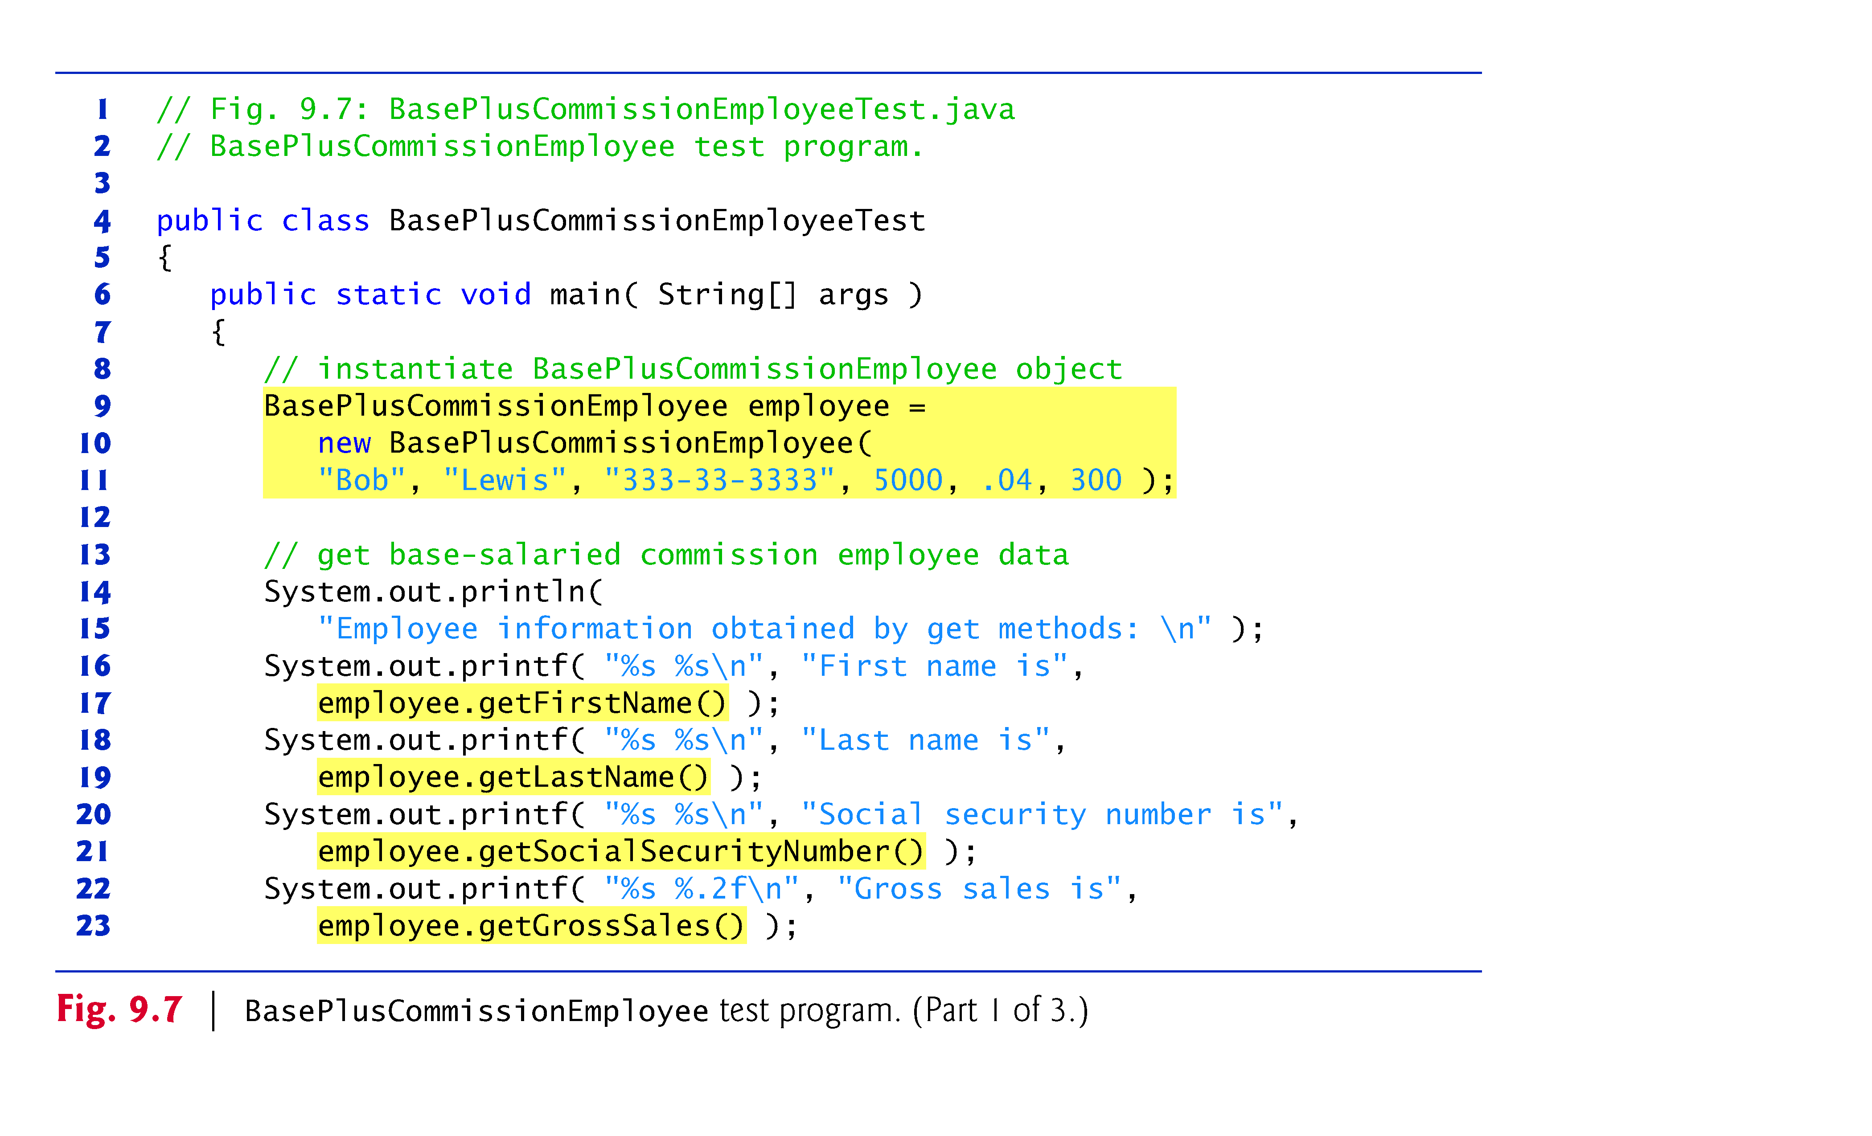

Slide 41
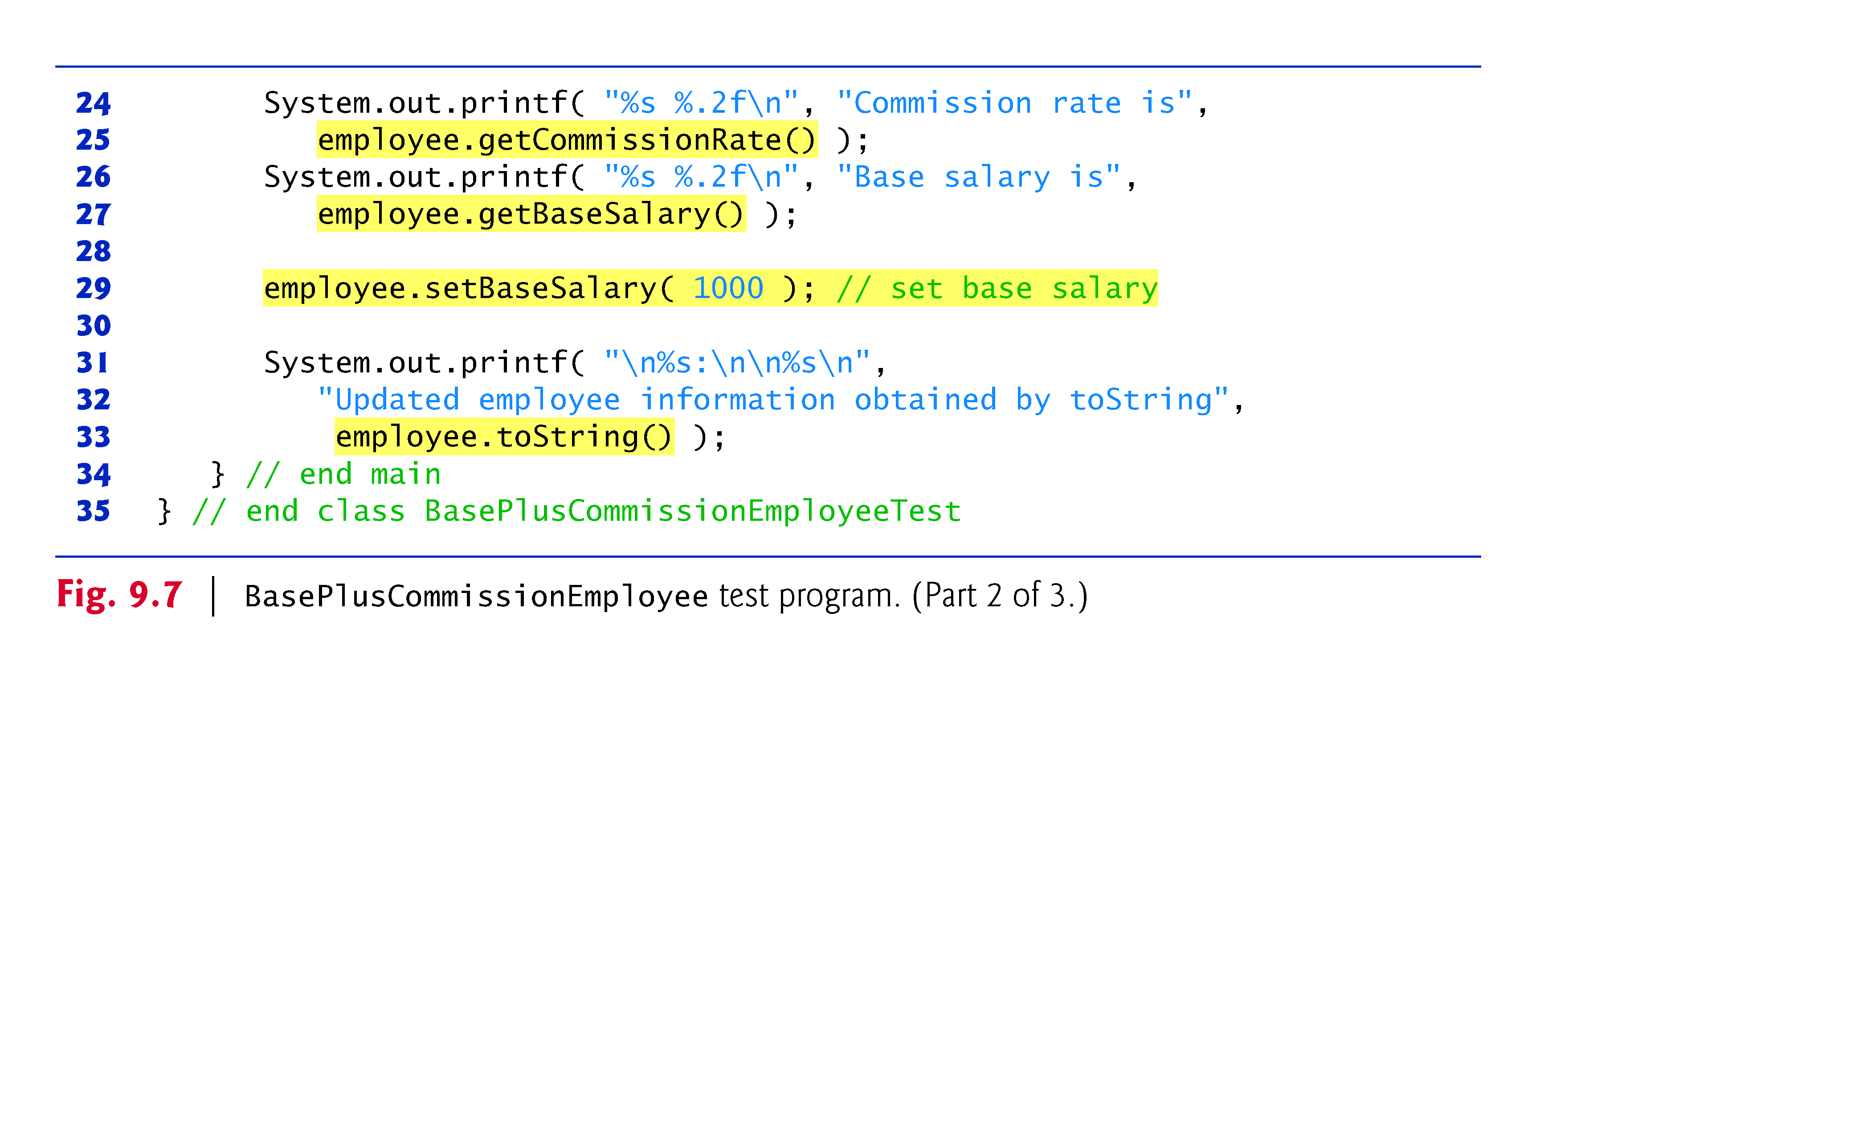

Slide 42
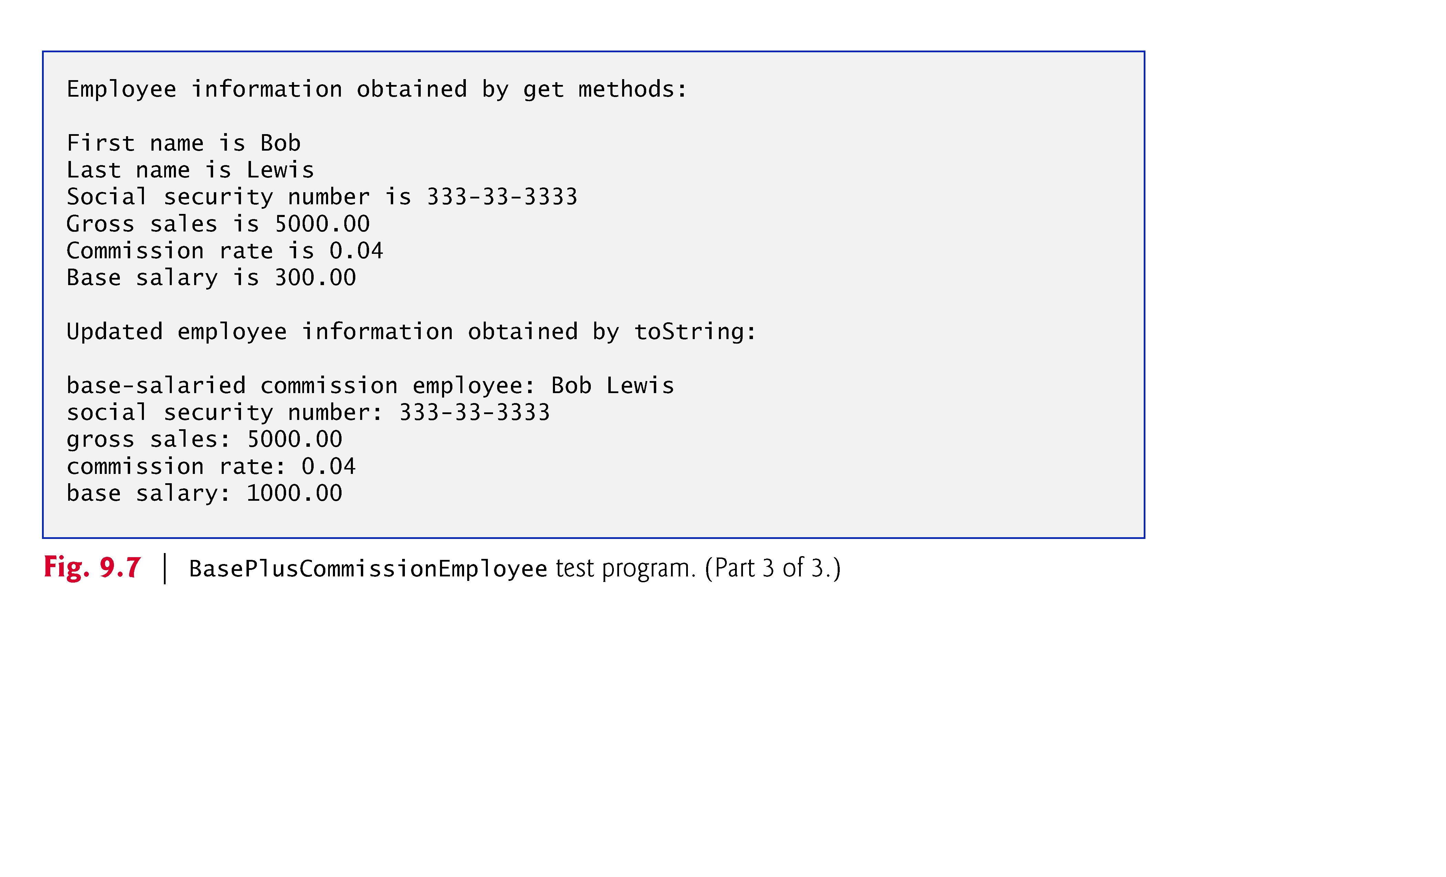

Slide 43
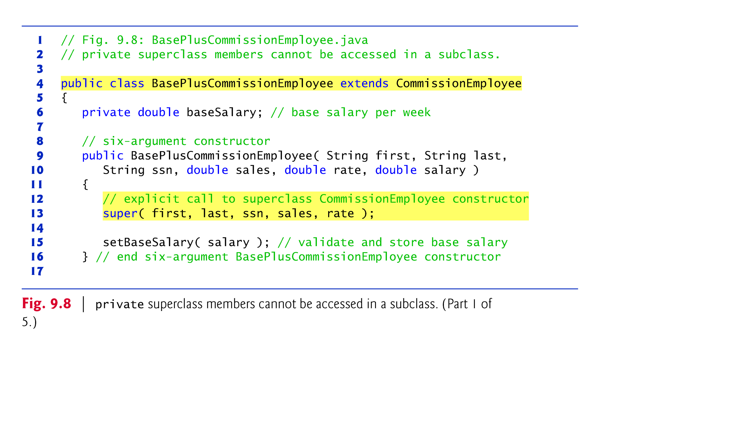

Slide 44
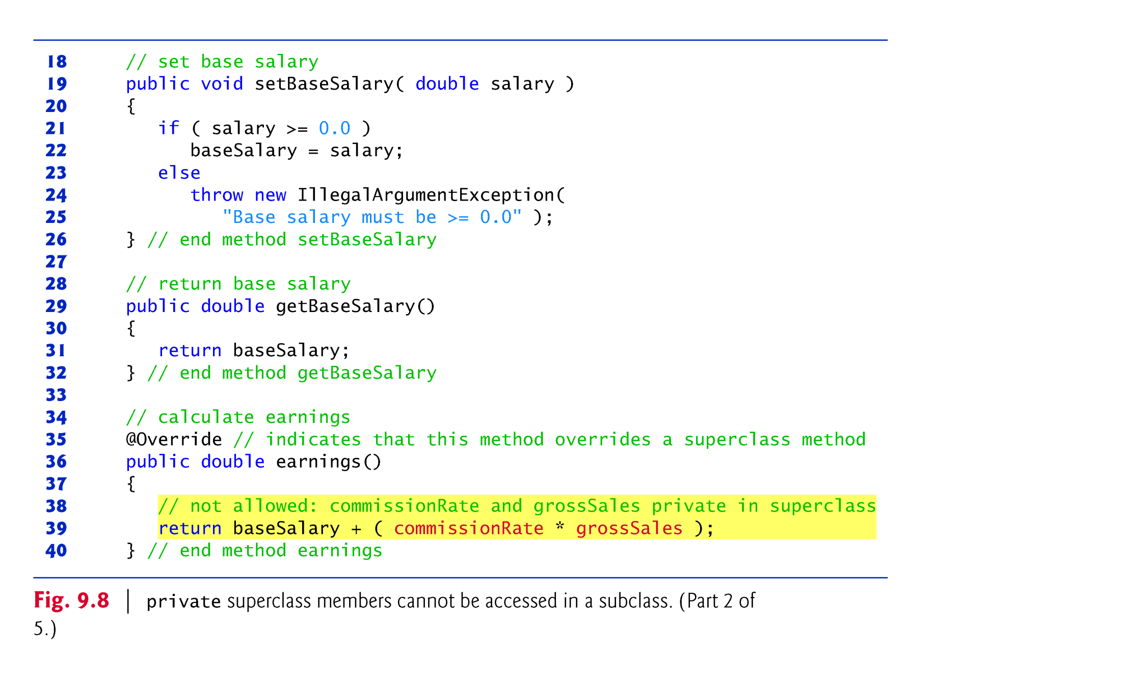

Slide 45
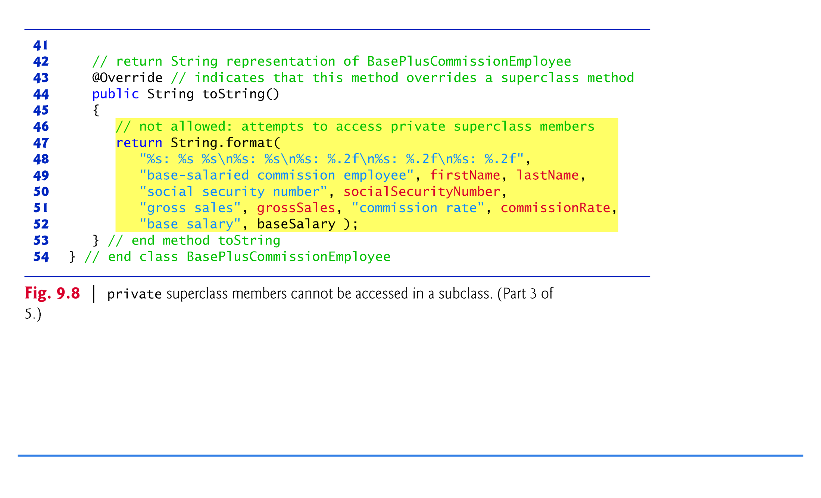

Slide 46
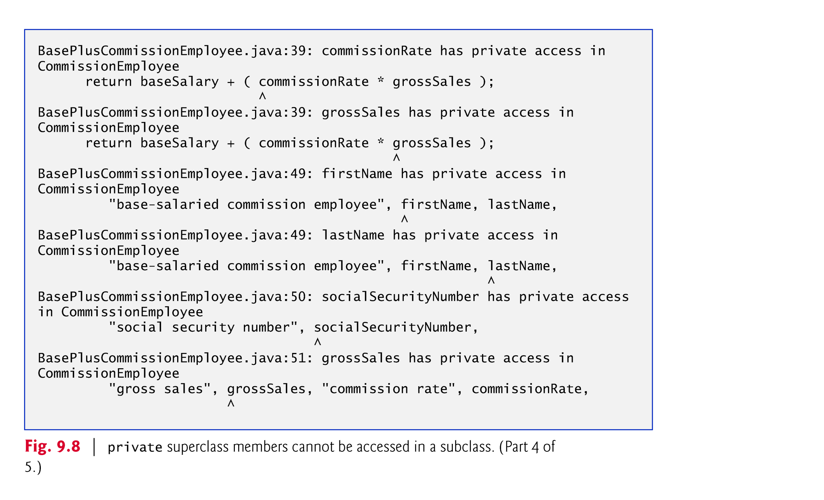

Slide 47


Slide 48
9.4.3 Creating a CommissionEmployee–BasePlusCommissionEmployee Inheritance Hierarchy (Cont.)
You can explicitly use super() to call the superclass’s no-argument or default constructor, but this is rarely done.

Slide 49
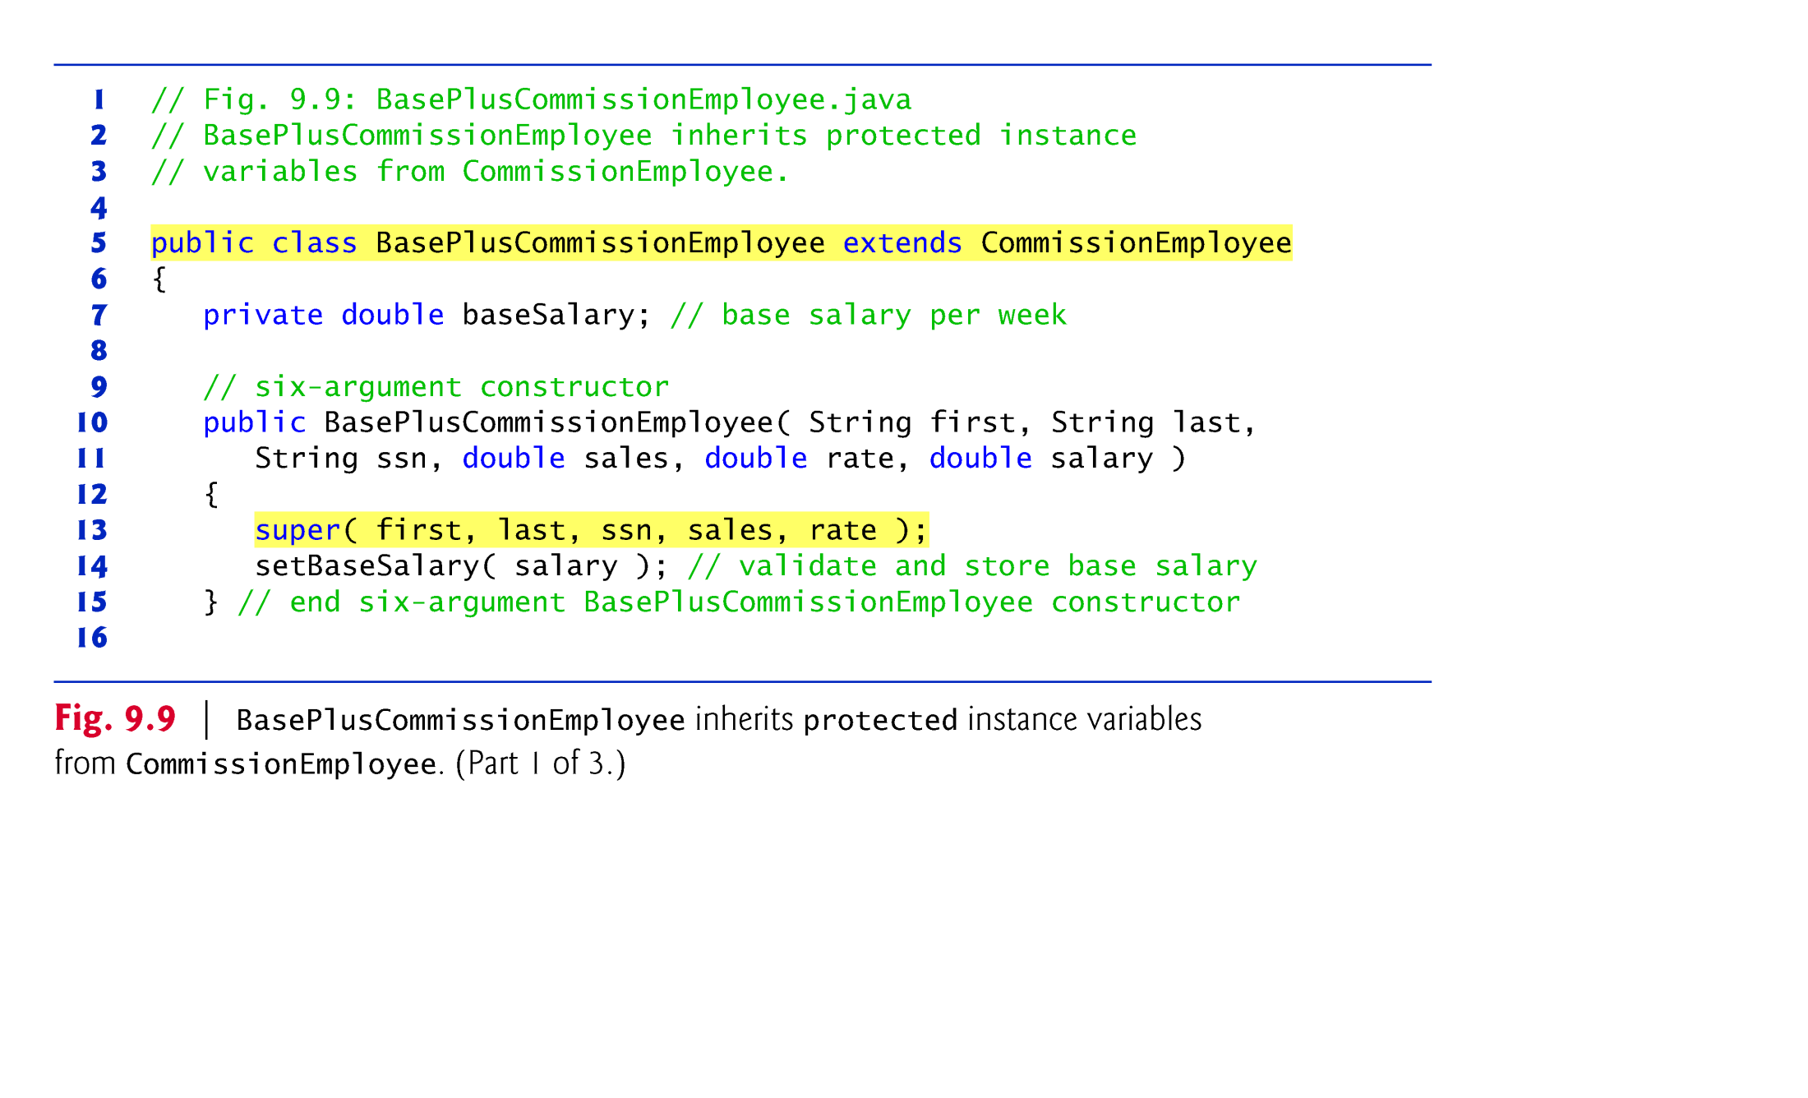

Slide 50
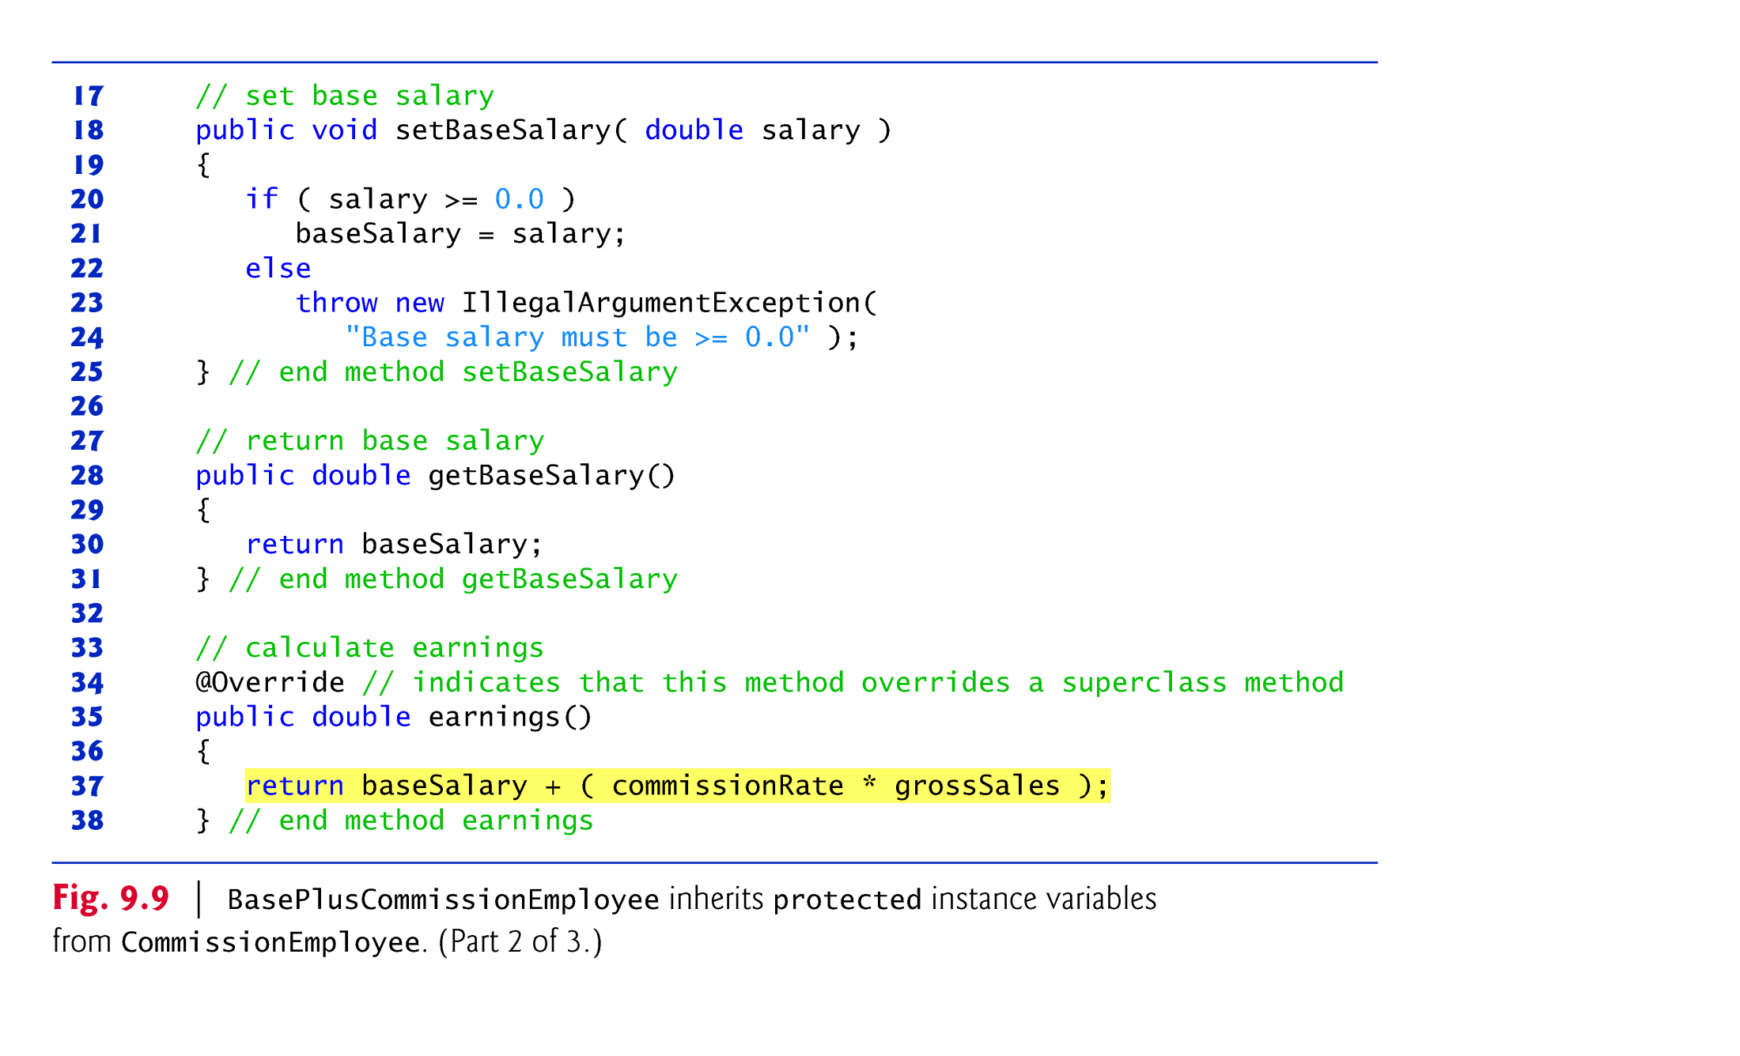

Slide 51
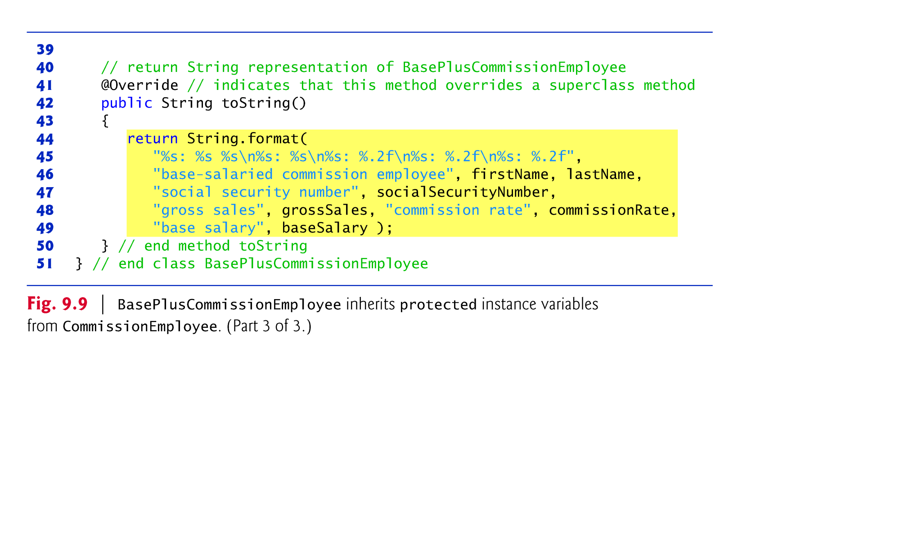

Slide 52
9.4.4 CommissionEmployee–BasePlus-CommissionEmployee Inheritance Hierarchy Using protected Instance Variables (Cont.)
Inheriting protected instance variables slightly increases performance, because we can directly access the variables in the subclass without incurring the overhead of a set or get method call.
In most cases, it’s better to use private instance variables to encourage proper software engineering, and leave code optimization issues to the compiler.
Code will be easier to maintain, modify and debug.

Slide 53


Slide 54
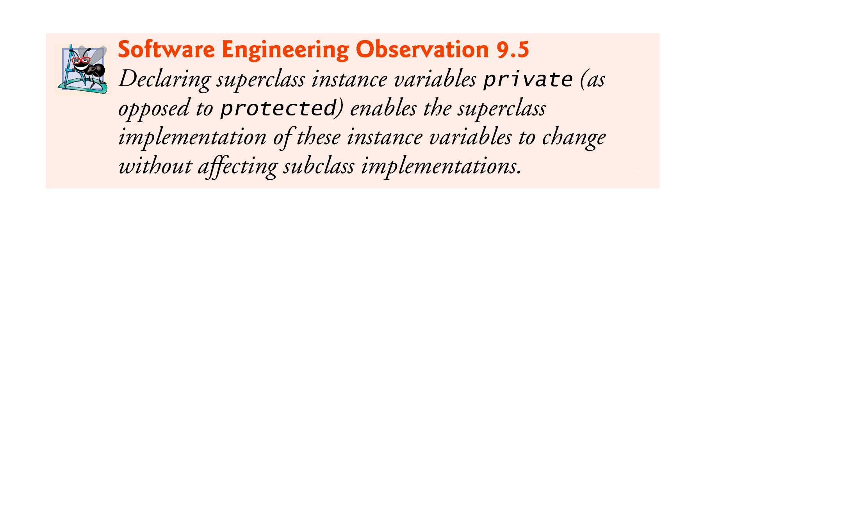

Slide 55
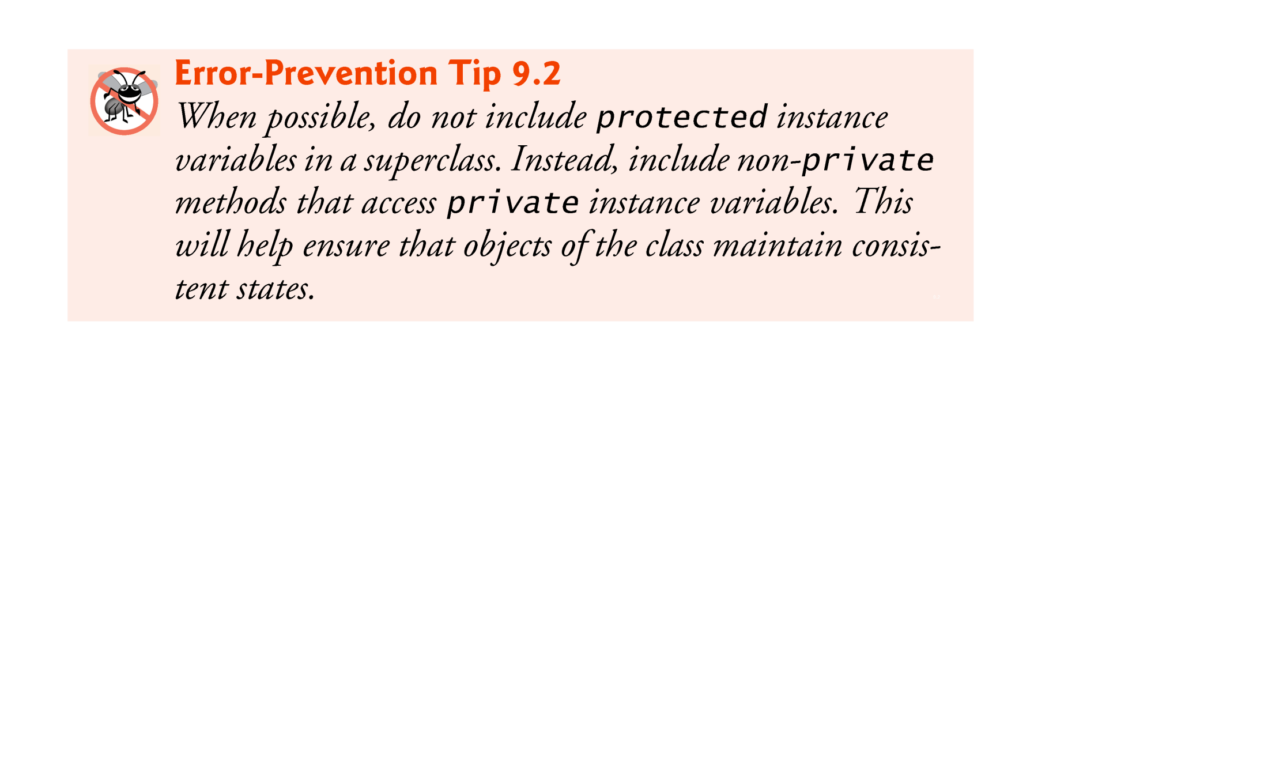

Slide 56
9.4.5 CommissionEmployee–BasePlus-CommissionEmployee Inheritance Hierarchy Using private Instance Variables
Hierarchy reengineered using good software engineering practices.
Class CommissionEmployee declares instance variables firstName, lastName, socialSecurityNumber, grossSales and commissionRate as private and provides public methods for manipulating these values.

Slide 57
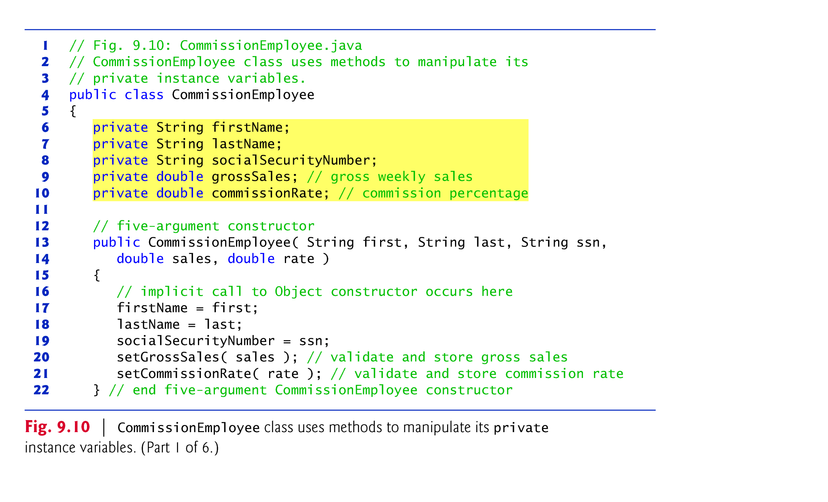

Slide 58
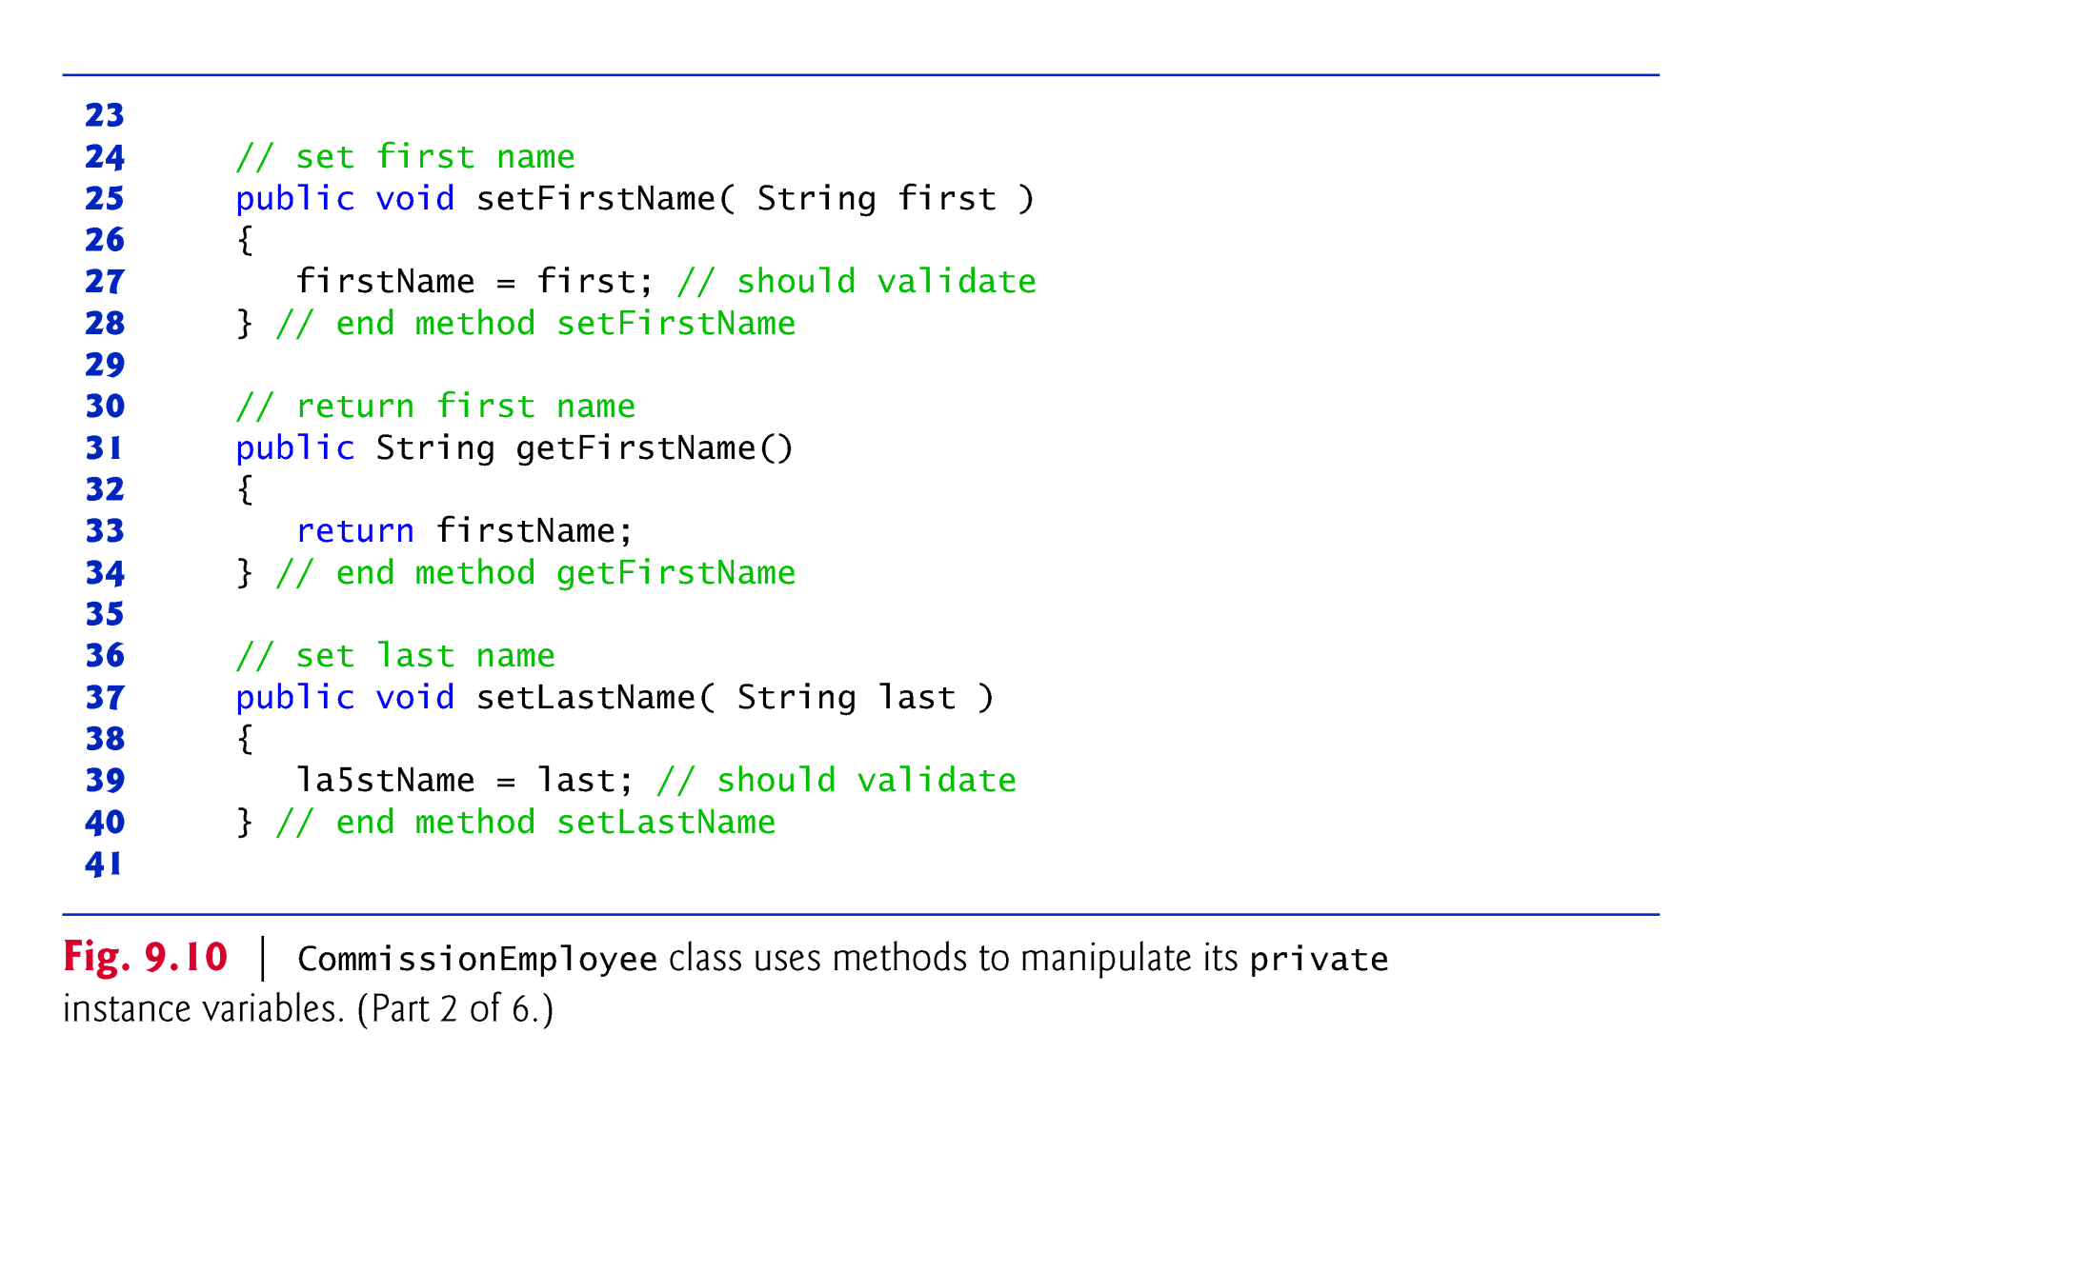

Slide 59


Slide 60
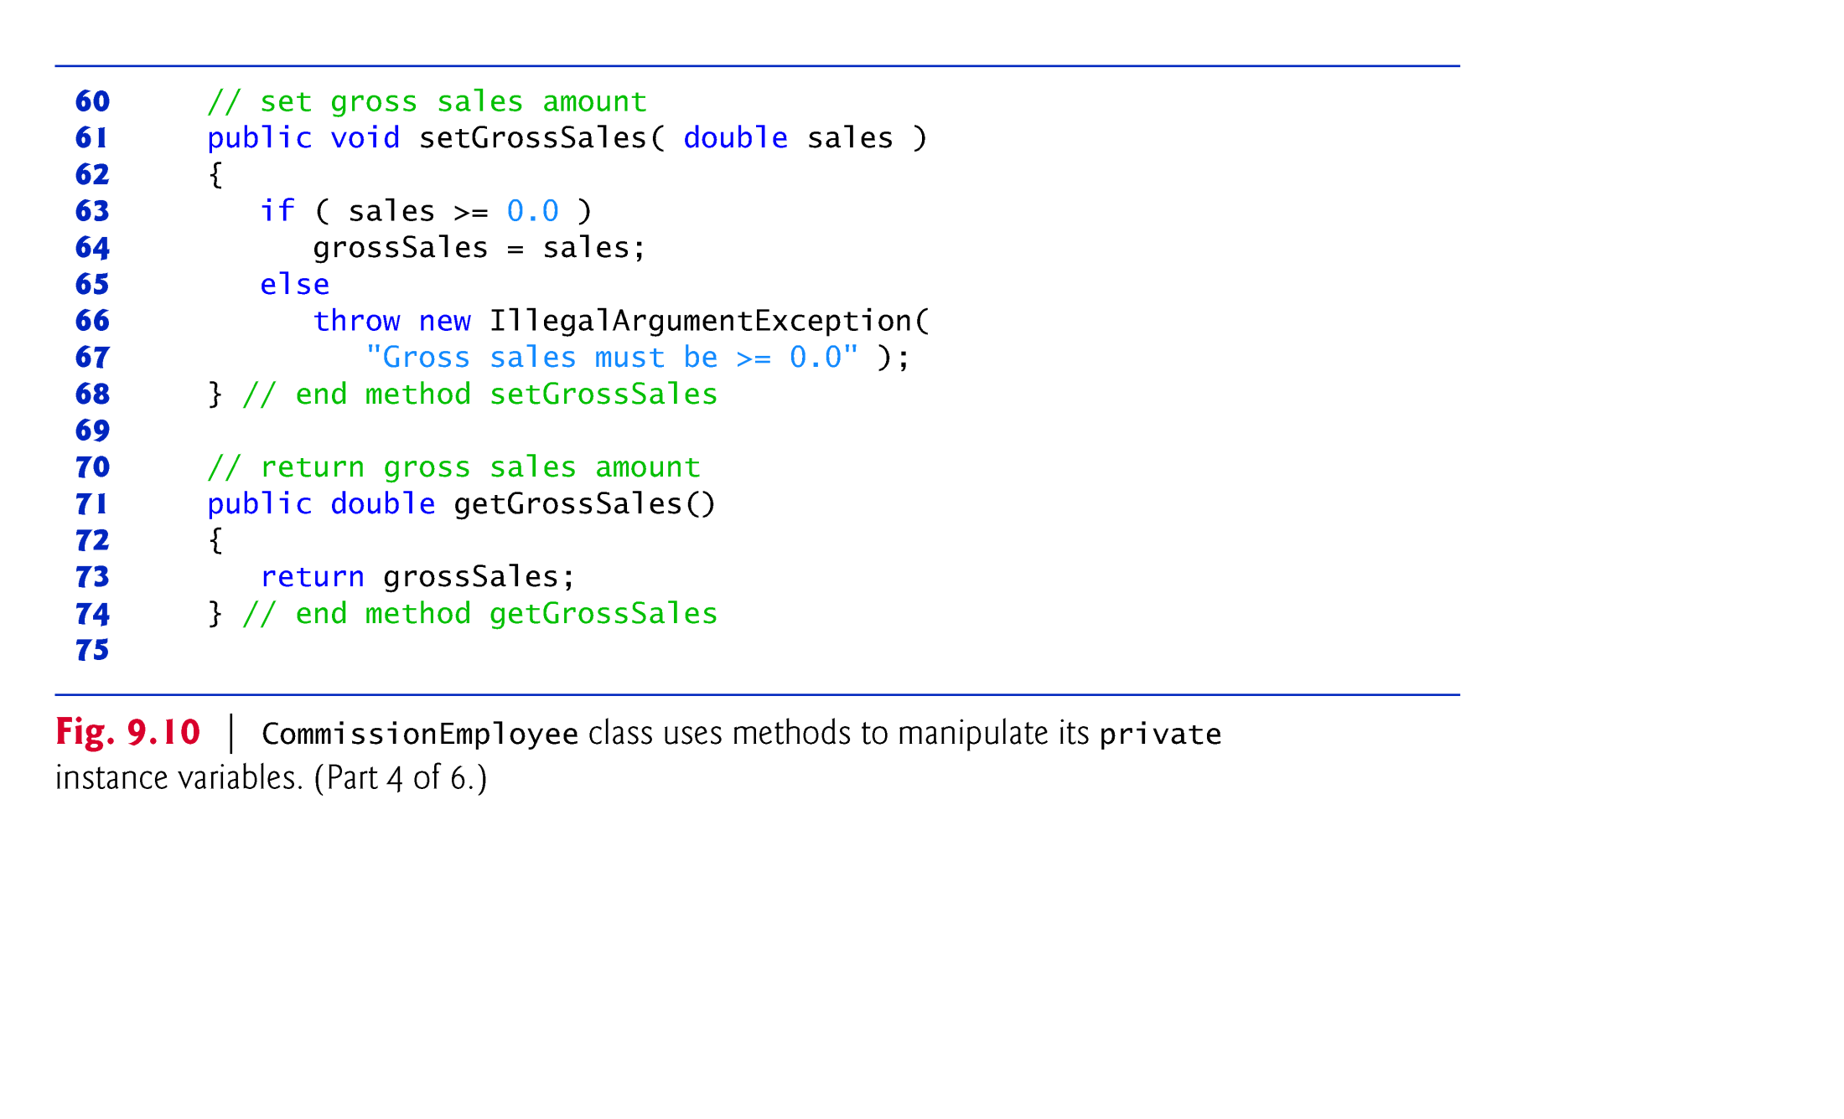

Slide 61
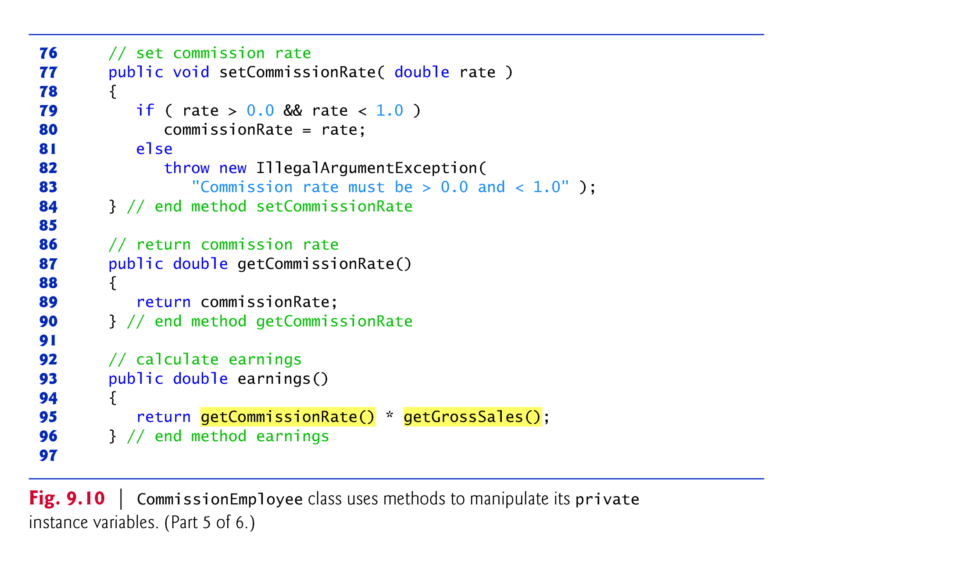

Slide 62
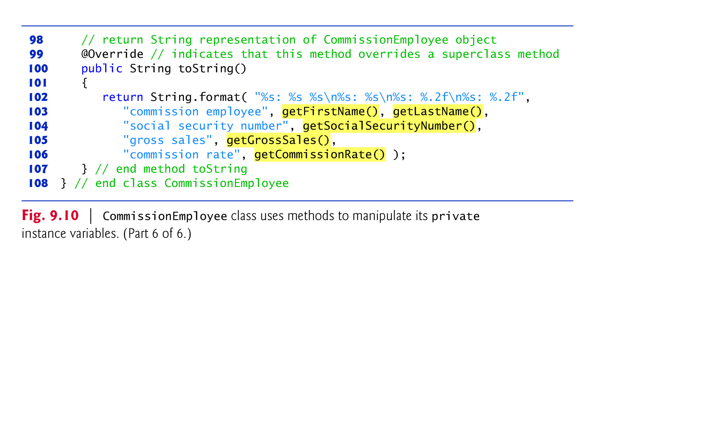

Slide 63
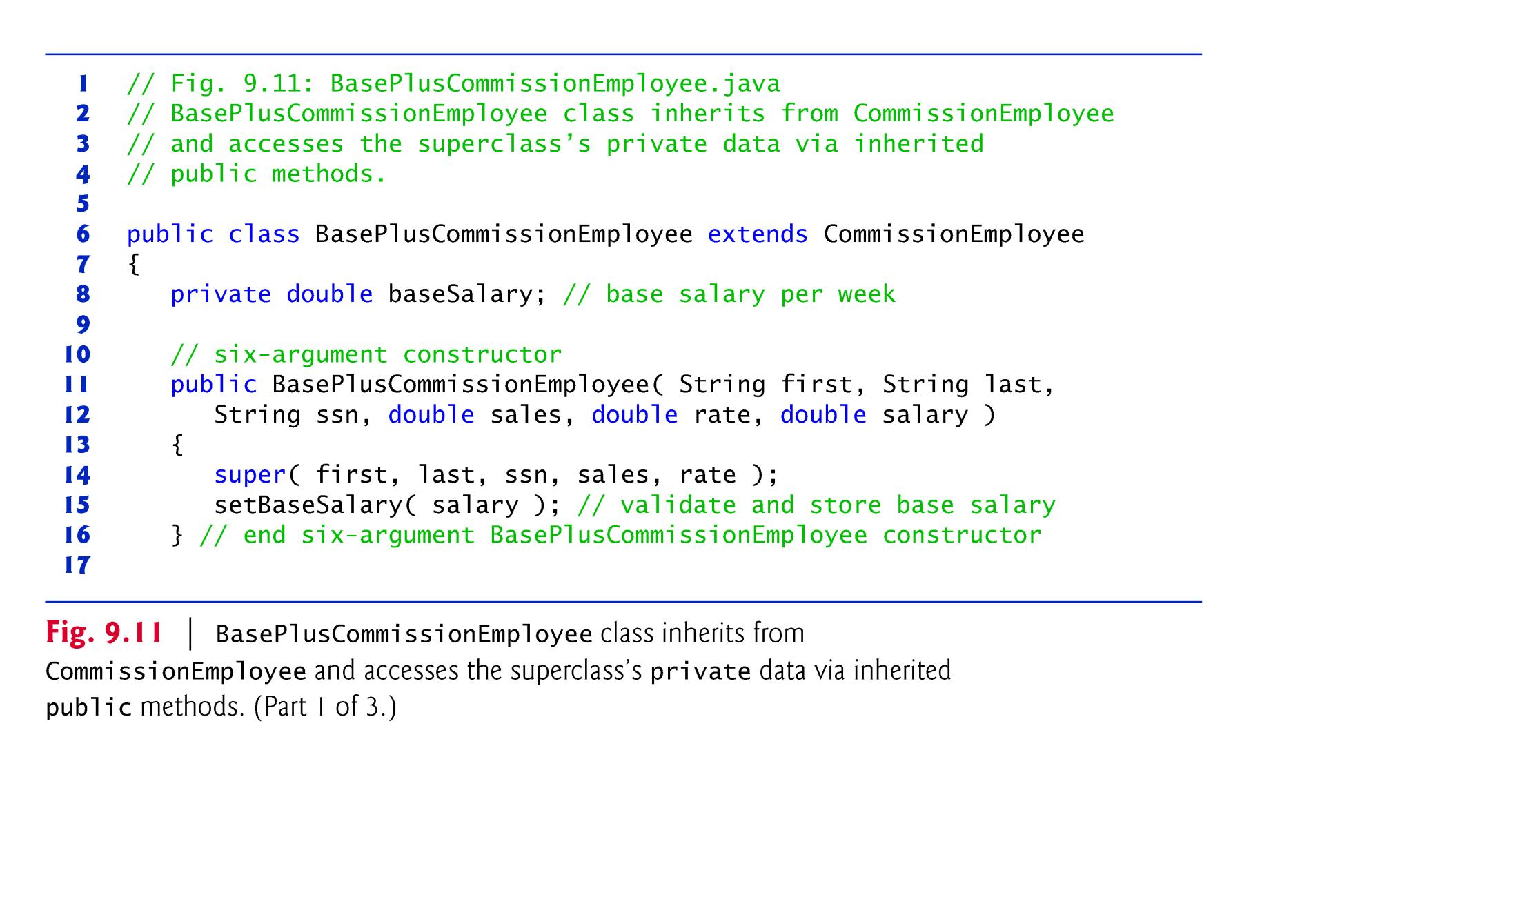

Slide 64
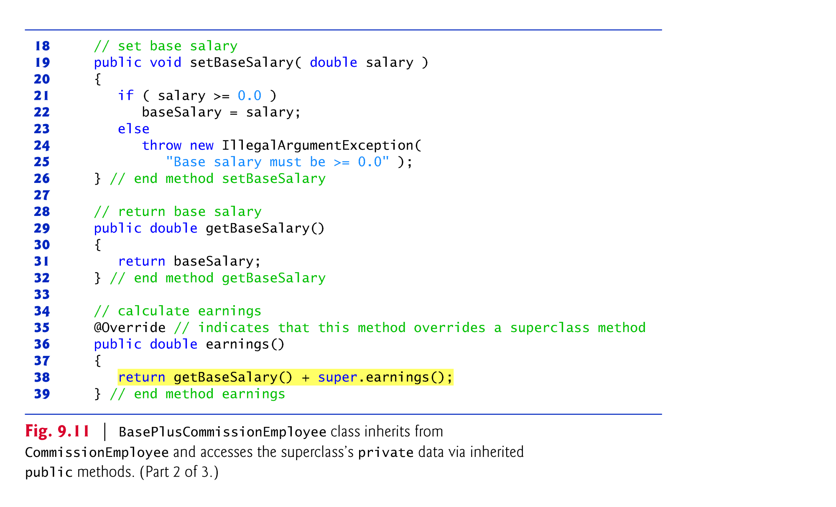

Slide 65
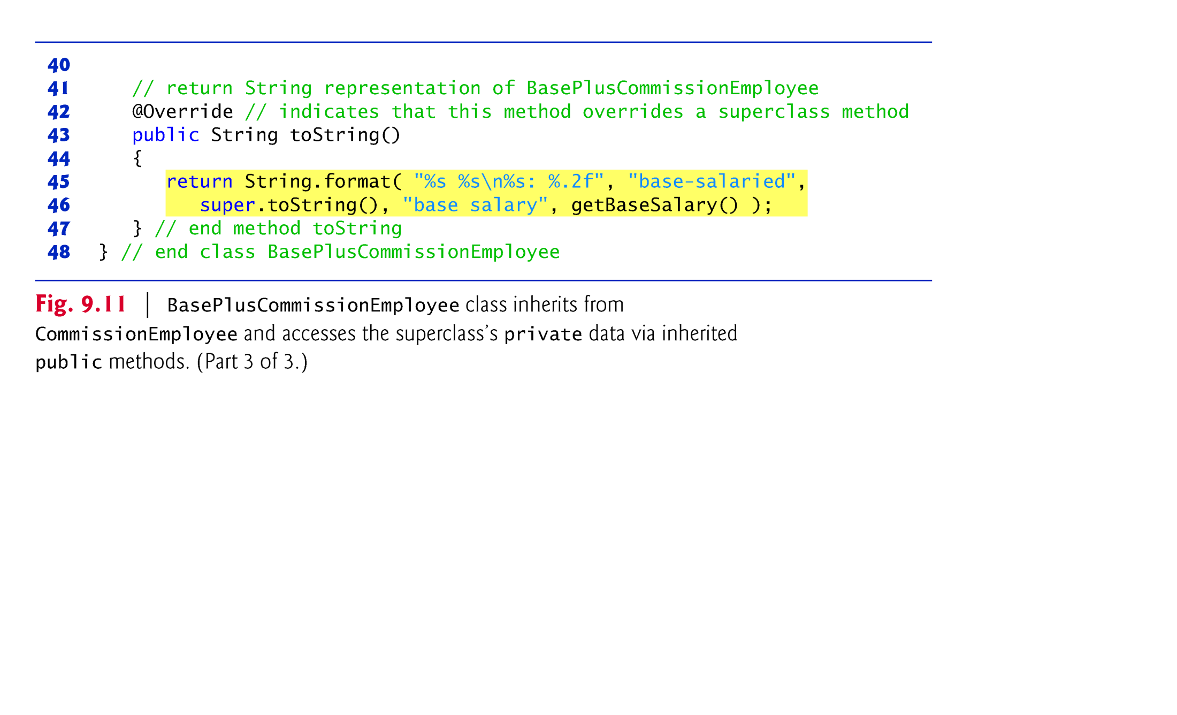

Slide 66
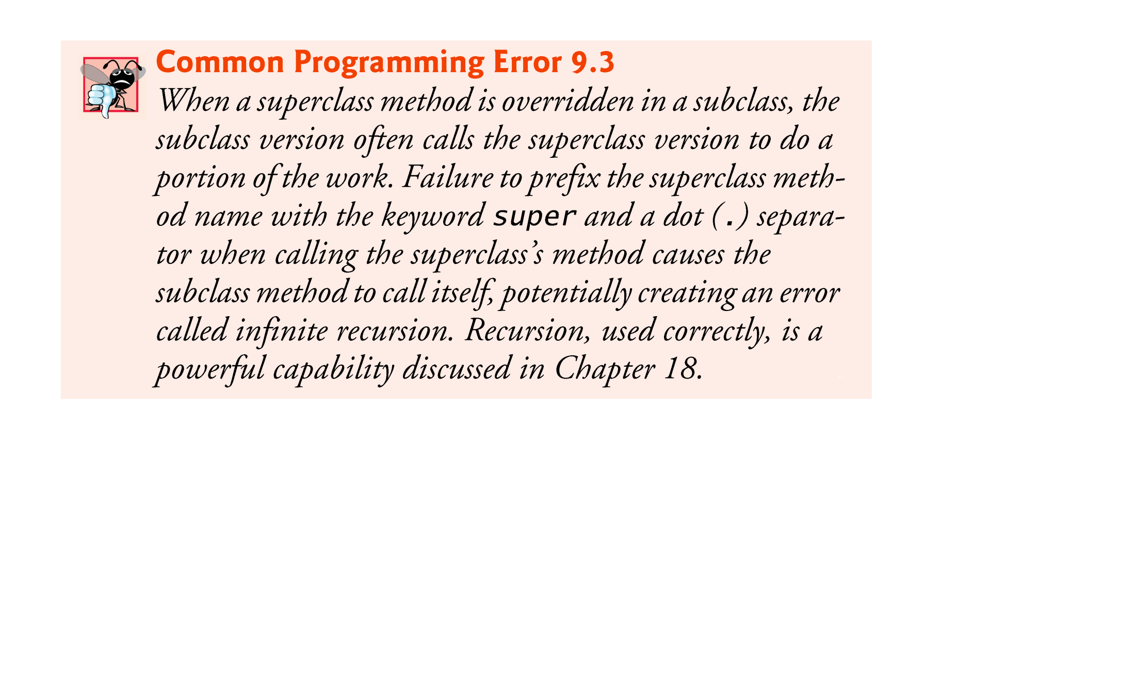

Slide 67
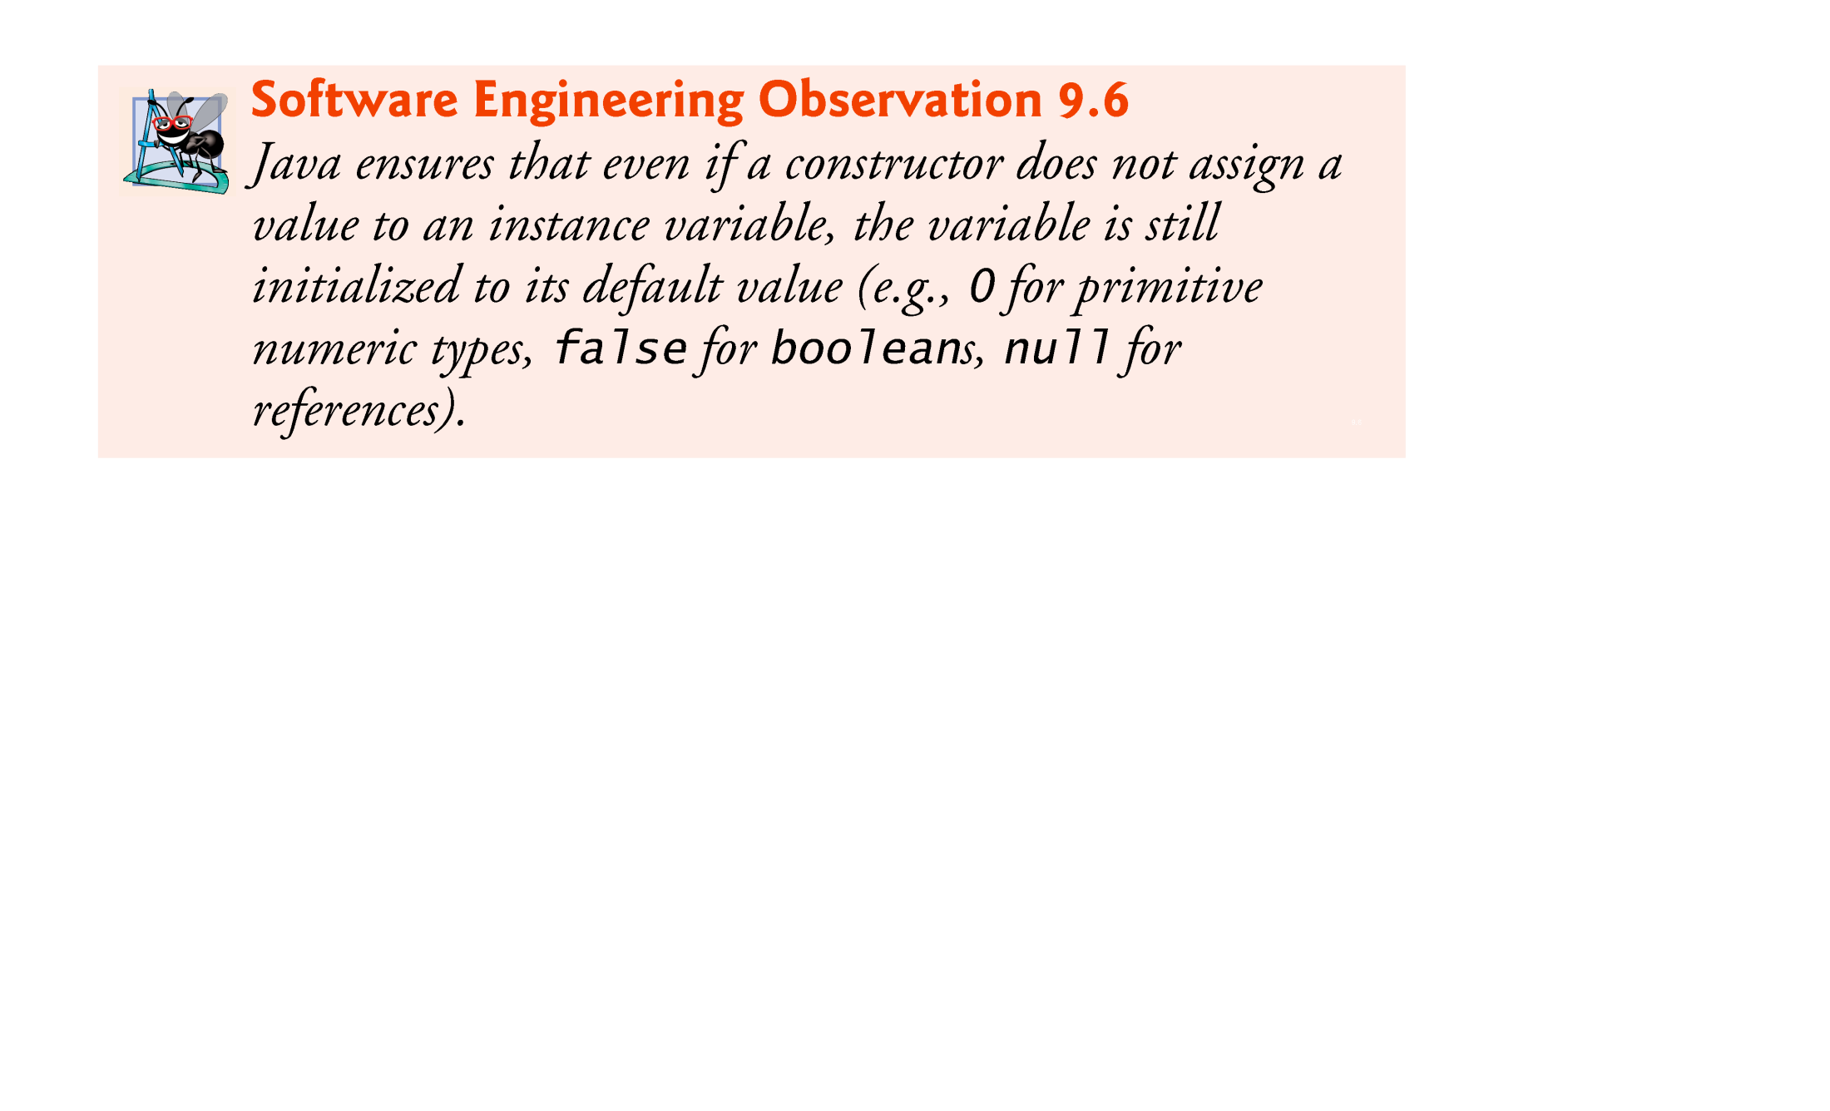

Slide 68
9.5 Object Class
All classes in Java inherit directly or indirectly from Object, so its 11 methods are inherited by all other classes.
Figure 9.12 summarizes Object’s methods.
Every array has an overridden clone method that copies the array.
If the array stores references to objects, the objects are not copied—a shallow copy is performed.

Slide 69
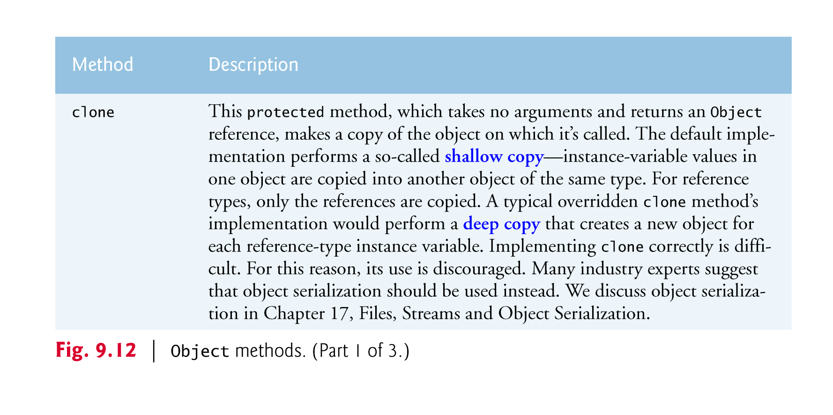

Slide 70
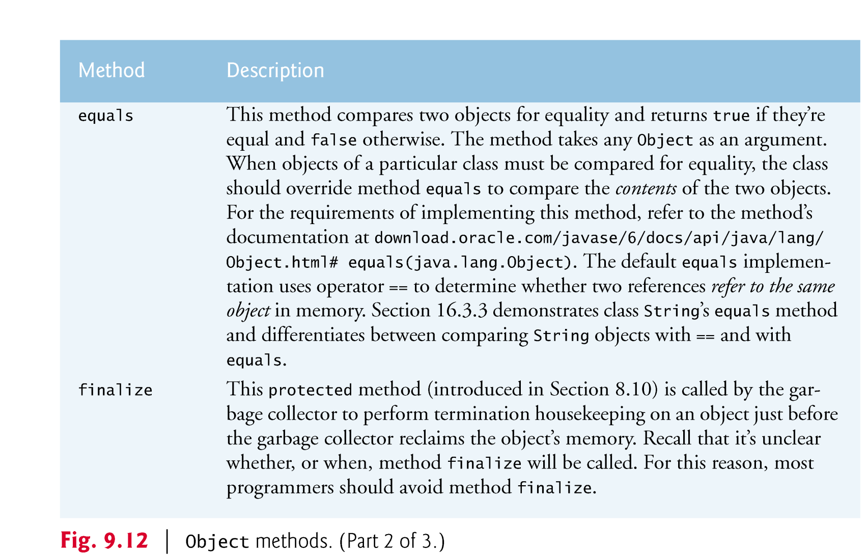

Slide 71
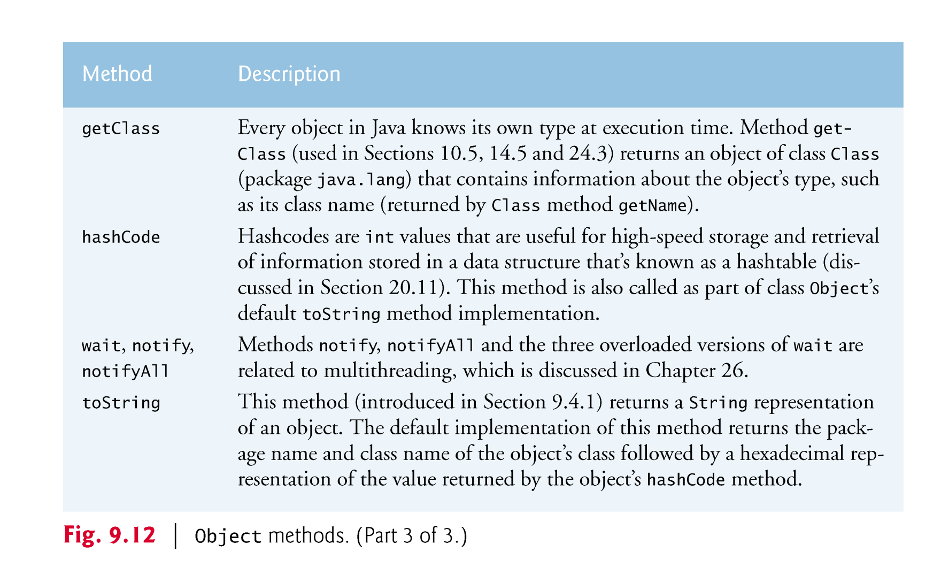

Slide 72
9.6 Designing with Composition vs. inheritance
Inheritance-Based Designs
Inheritance creates tight coupling among the classes in a hierarchy
Inheritance is done at compile time.
you should use inheritance only for true is-a relationships in which you can assign a subclass object to a superclass reference.

Slide 73
9.6 Designing with Composition vs. inheritance(Cont.)
Composition-Based Designs
Composition is loosely coupled.
Composition can be done at compile time(final reference), but it also can be done at execution time(non-final referece).

Slide 74
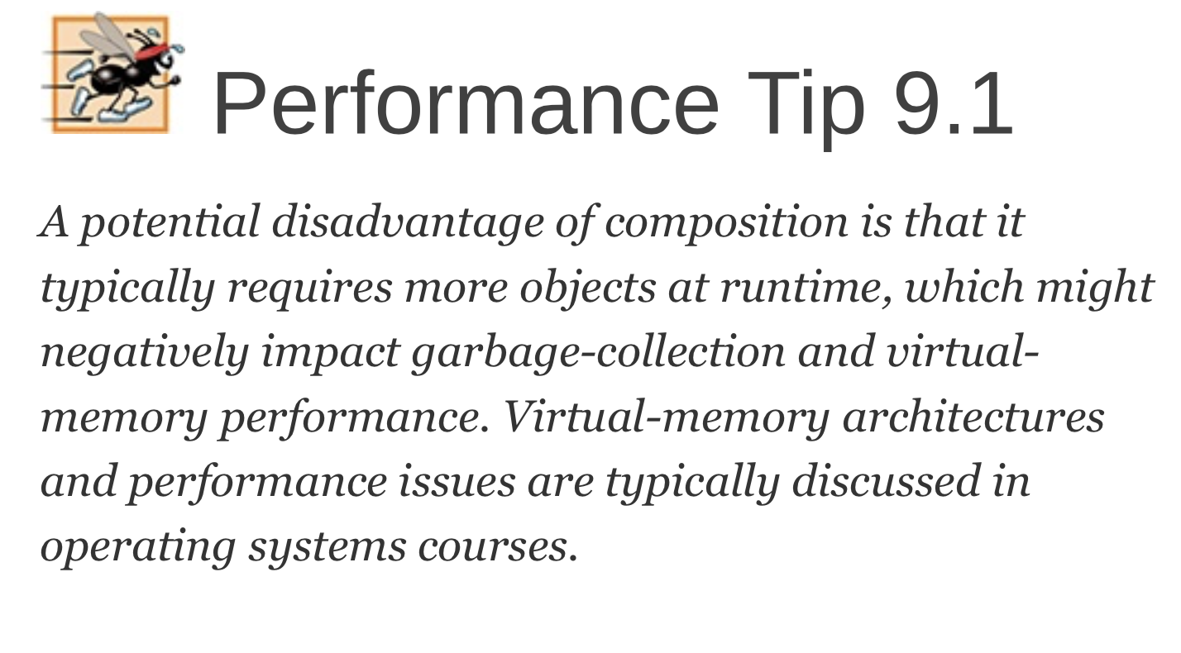

Slide 75
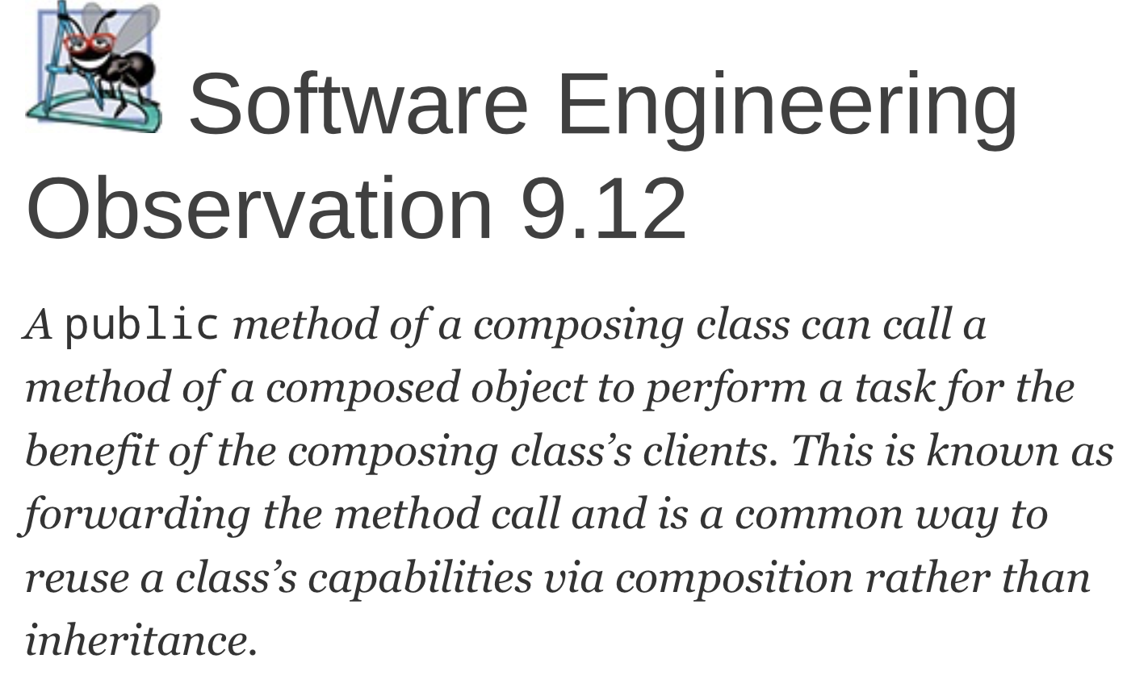

Slide 76
